Slide 1
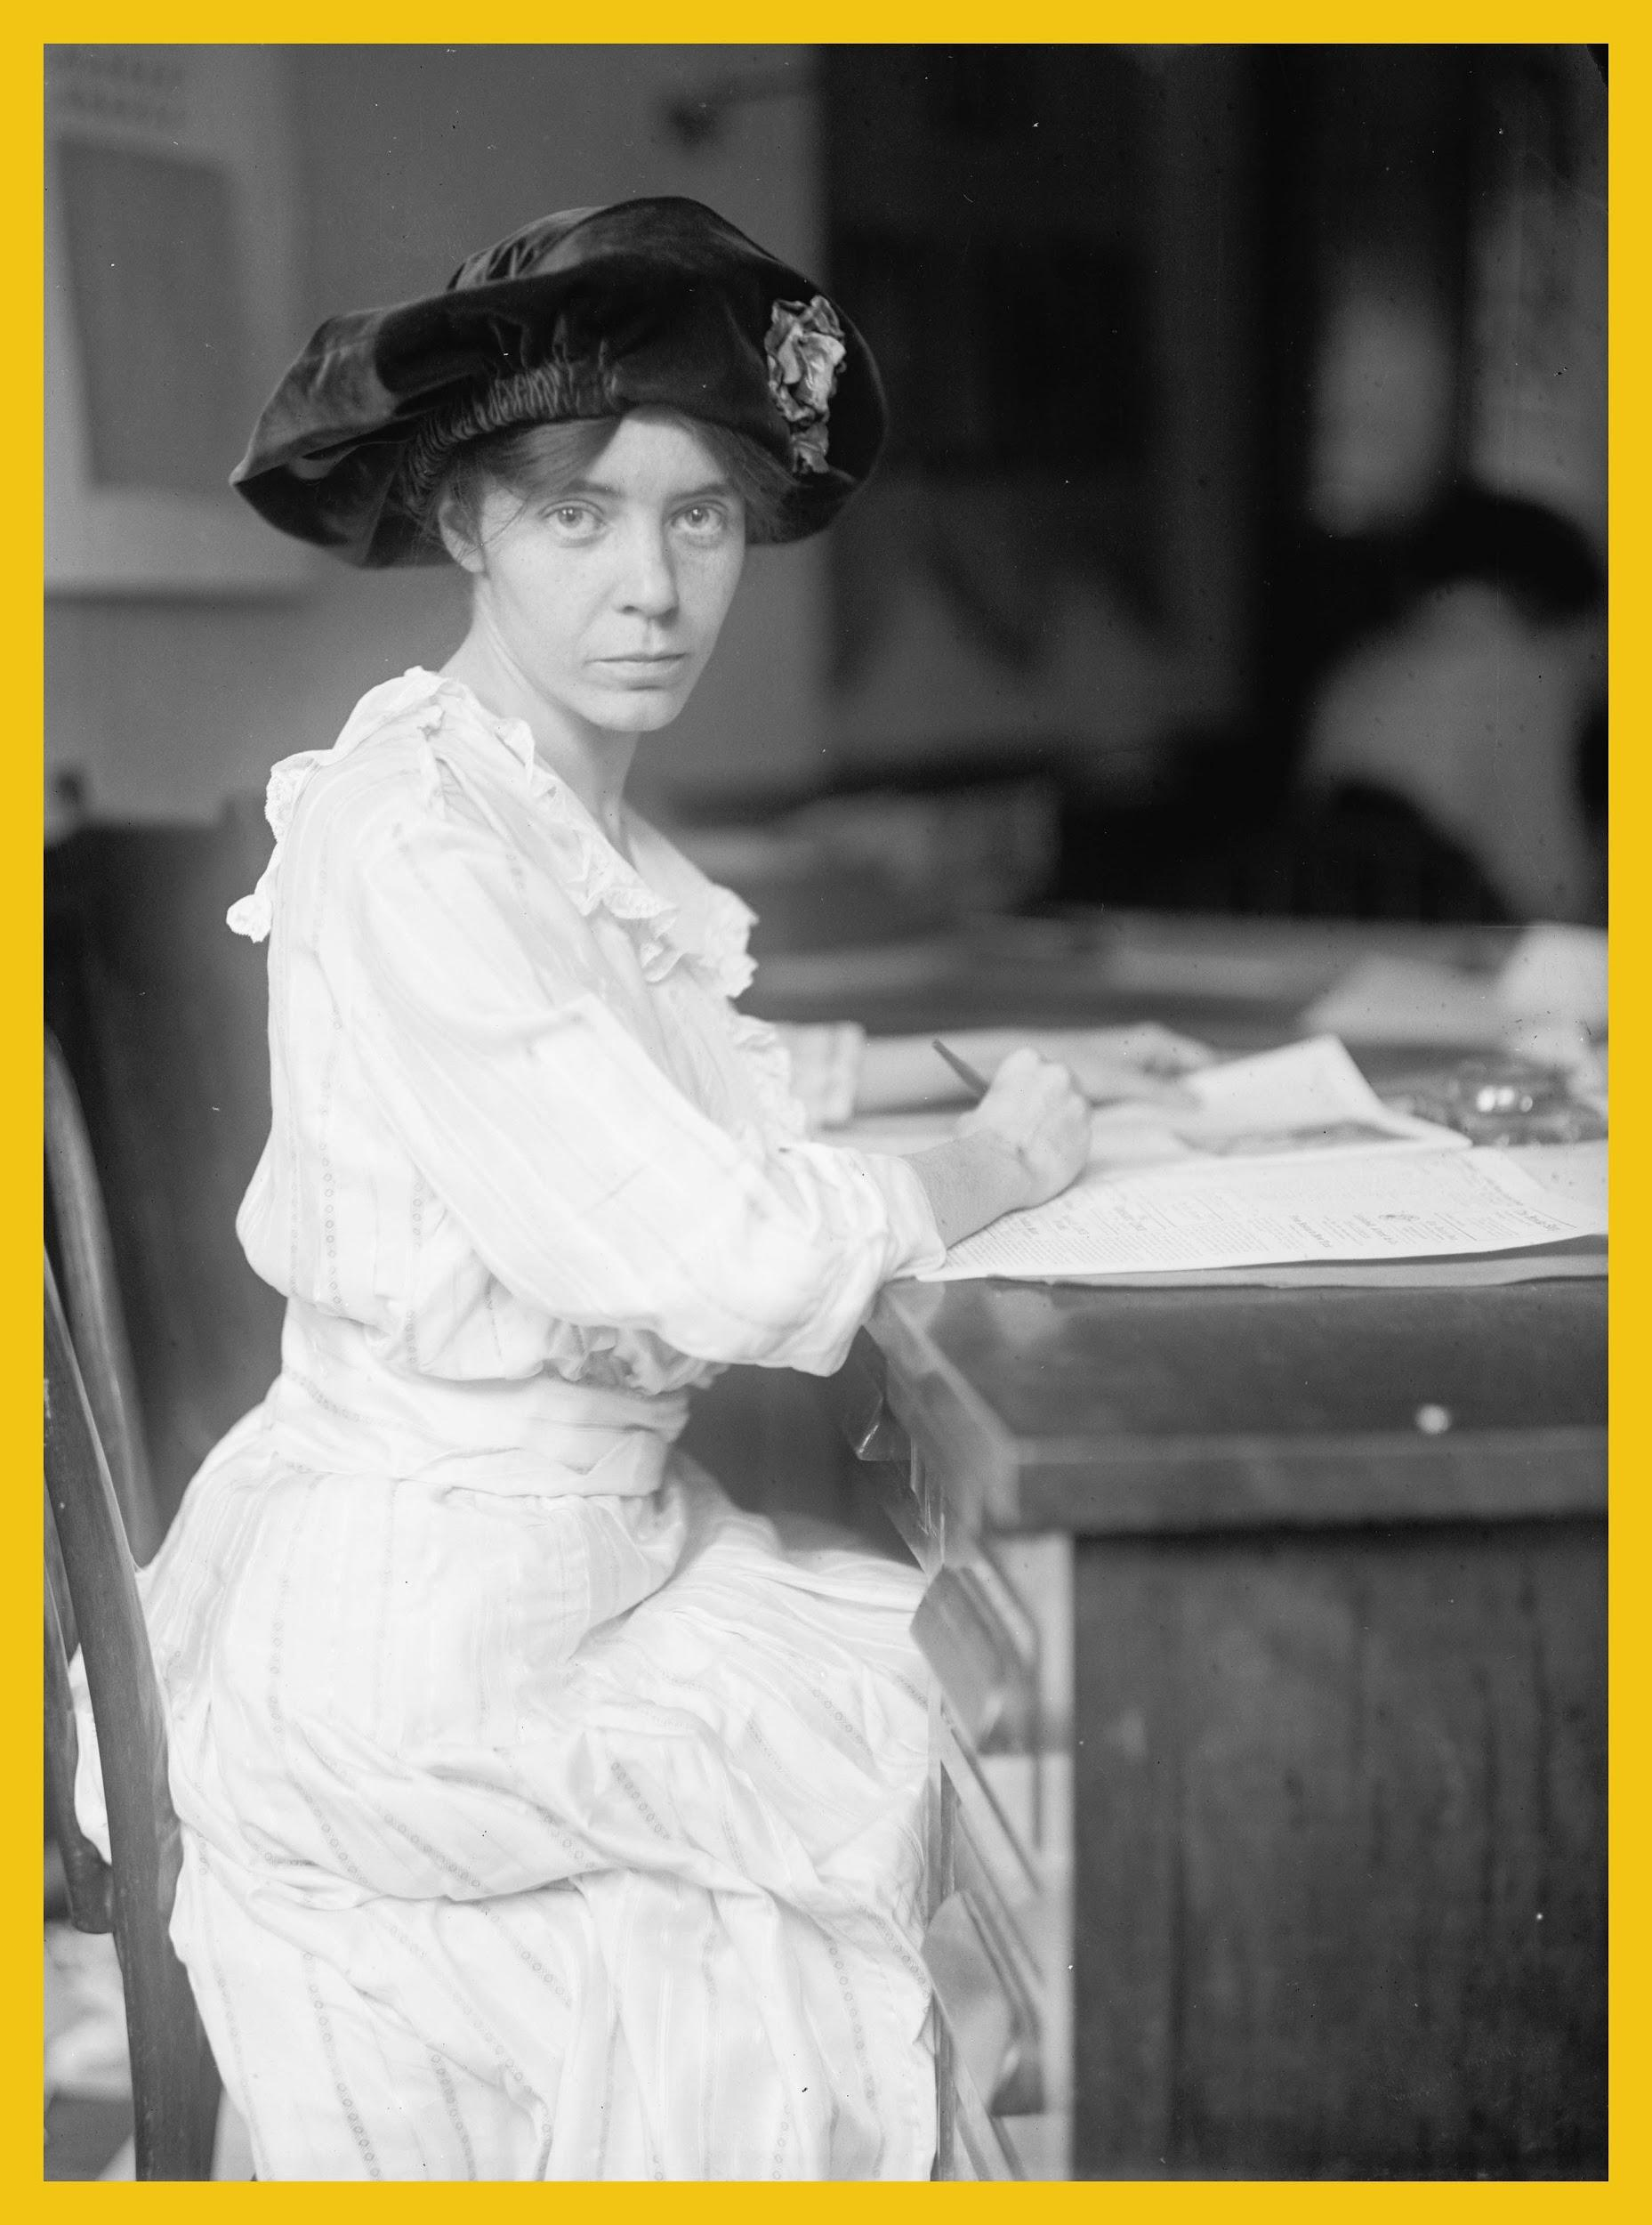
Meeting
Alice
Suffragist & Equal Rights Activist
Alice Stokes Paul
1885-1977
Notes:
“Meeting Alice” is an educational presentation about Alice Stokes Paul (1885-1977), an American suffragist and equal rights activist, who believed that “one person can make a difference.”
Photo Credit: Library of Congress

Slide 2
Provided by:
Notes:
The “Meeting Alice” educational presentation was created and provided by the Alice Paul Institute, a non-profit organization located at Paulsdale, the birthplace of Alice Paul in Mt. Laurel, New Jersey. The mission of the Alice Paul Institute is to honor the legacy of Alice Paul’s work for gender equality through education and leadership development.
Learn more about Alice Paul and the Alice Paul Institute by visiting www.AlicePaul.org.

Slide 3
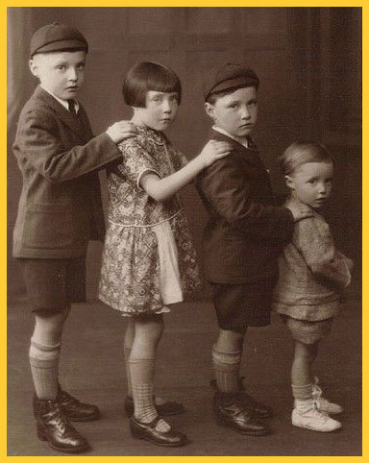
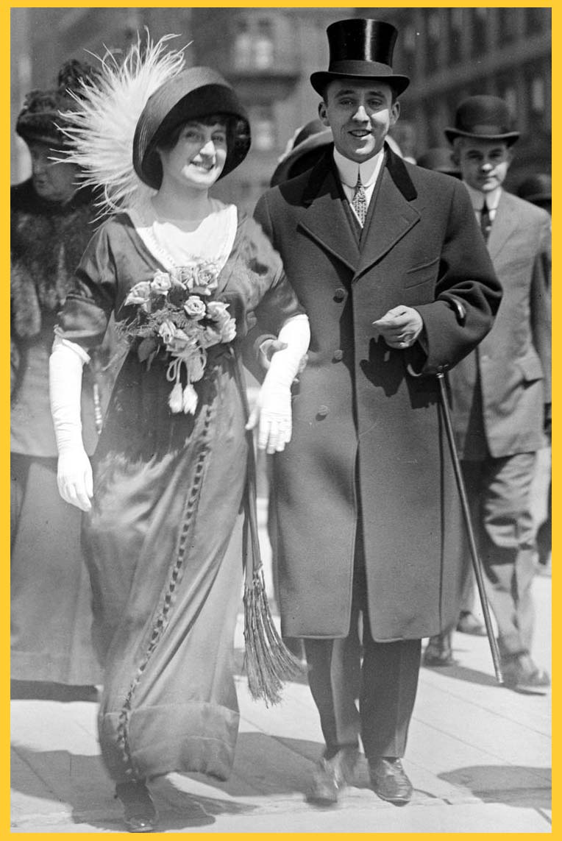
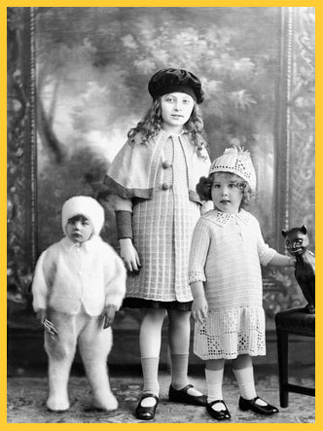
How Did People Live 100 Years Ago?
Notes:
When Alice was a child, about 100 years ago, this is the kind of clothing that was typically worn. Notice girls’ and women’s legs were covered. Young boys wore knickers.

Slide 4
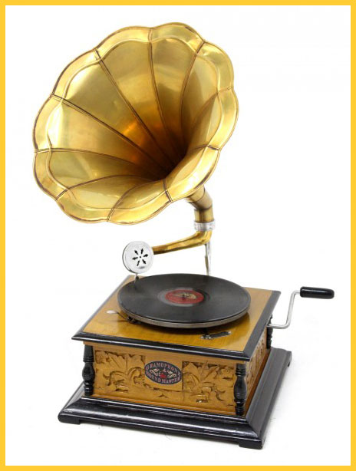
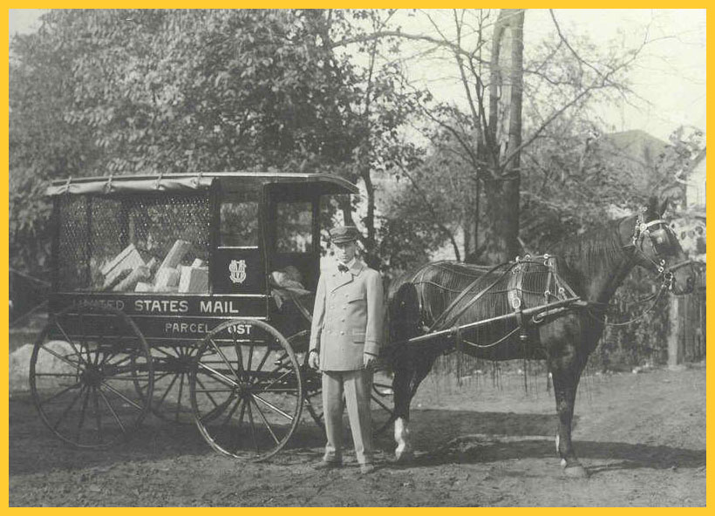
Things People Used 100 Years Ago
Notes:
The photos show examples of transportation, communication, and home entertainment in Alice's day
Teacher Note: Although cars were in existence, most people traveled by horse and carriage. Telephones like this would have been in some homes around 100 years ago. The Victrola played vinyl records. Notice the arm for cranking. Electricity was not widespread.
Teacher note: Discussion ideas
How have these items been modernized?

Slide 5
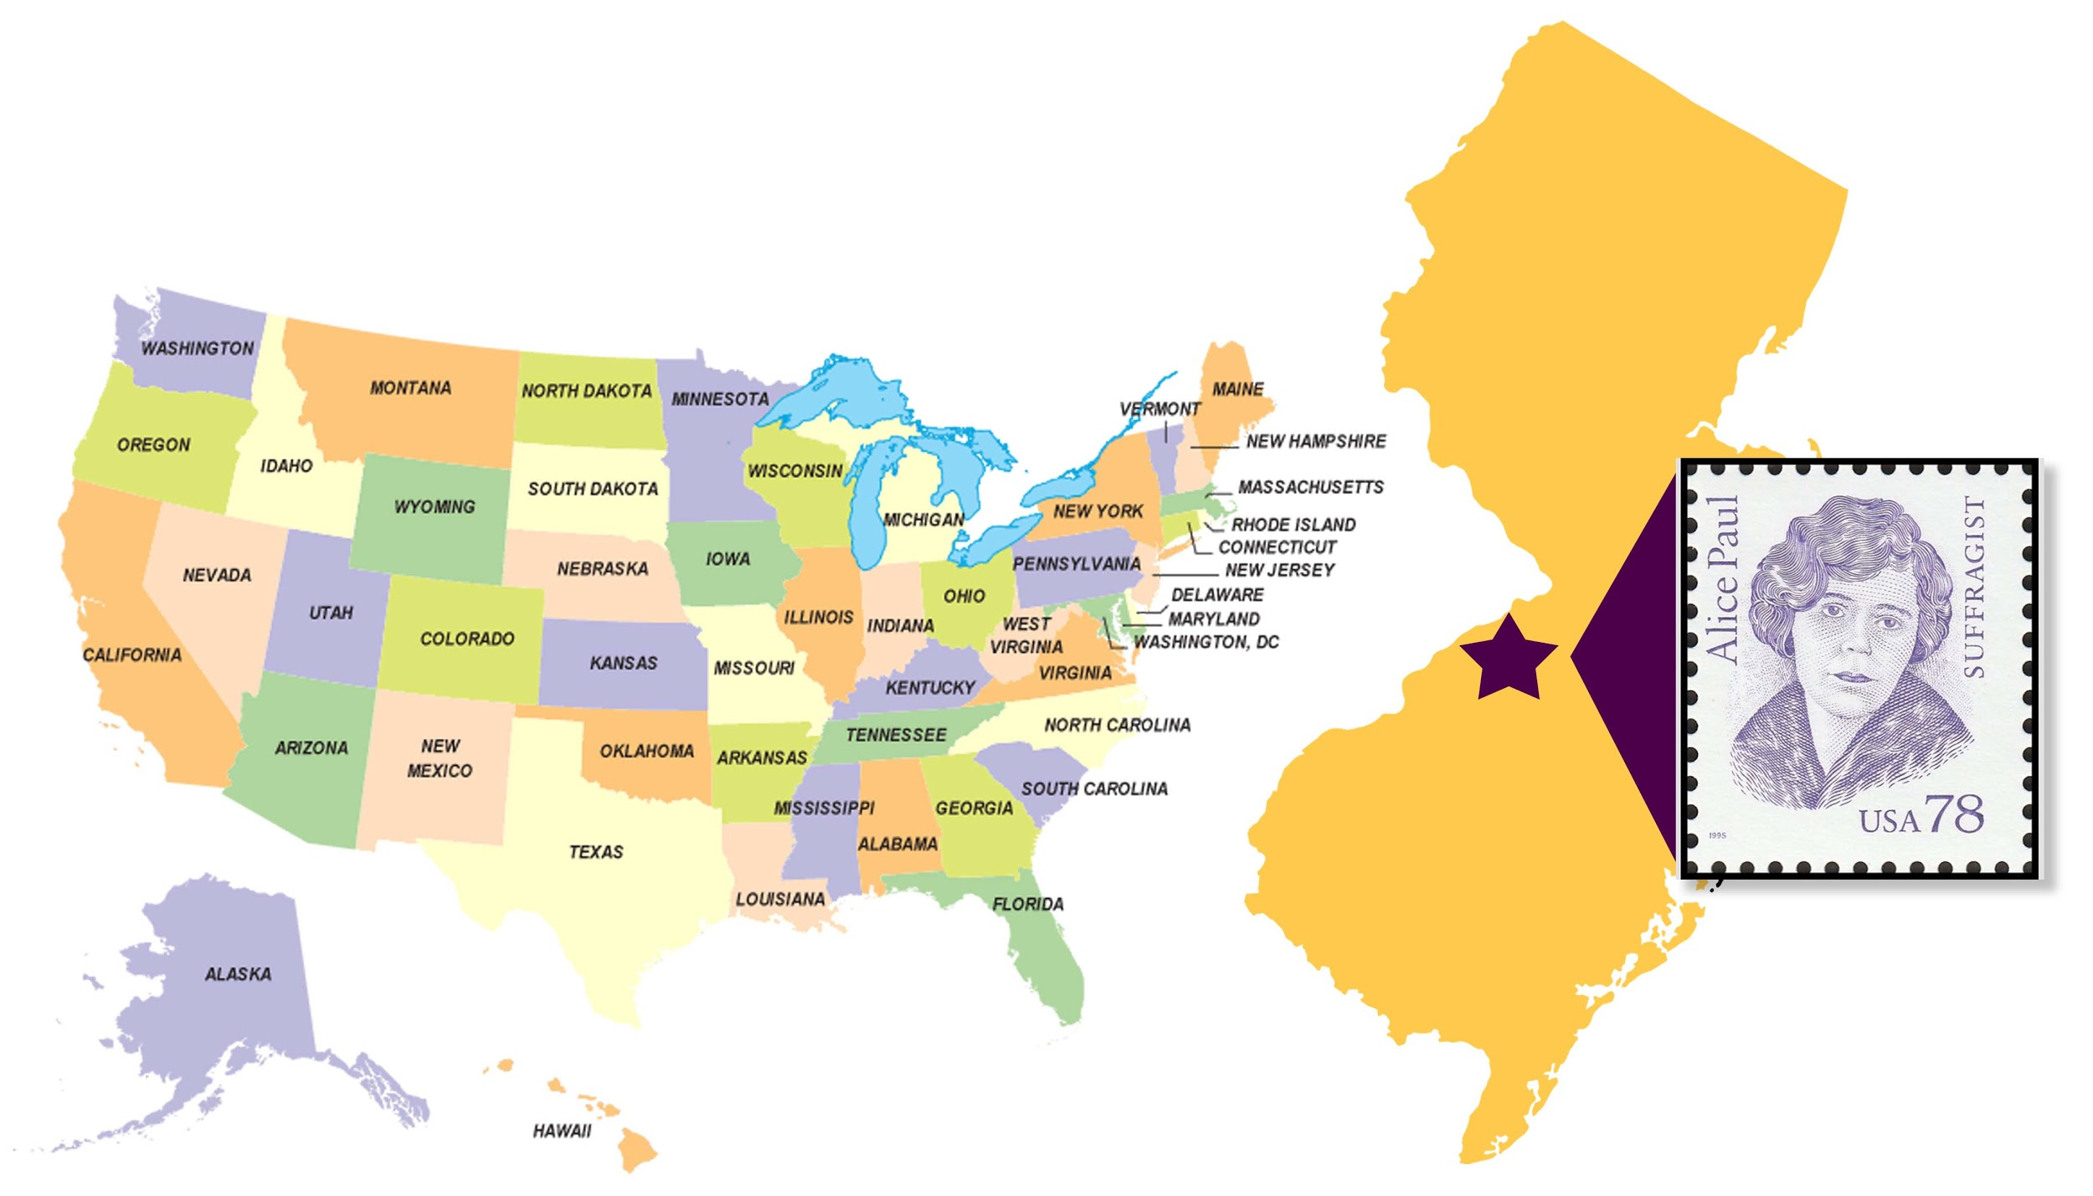
Where was Alice Paul born?
Notes:
Alice Paul was born on January 11, 1885, at Paulsdale, her family’s farm in Mt. Laurel, New Jersey. The state of New Jersey is located on the east coast of the United States.
Fun fact: In 1995, the United States Postal Service released a special edition stamp featuring Alice Paul. The stamp was released to commemorate the 75th anniversary of the passage of the 19th Amendment in 1920.
Teacher Note: Discussion Ideas:
Help students find New Jersey on the map of the U.S.
How far is New Jersey from our state?
Have any of you visited New Jersey before?

Slide 6
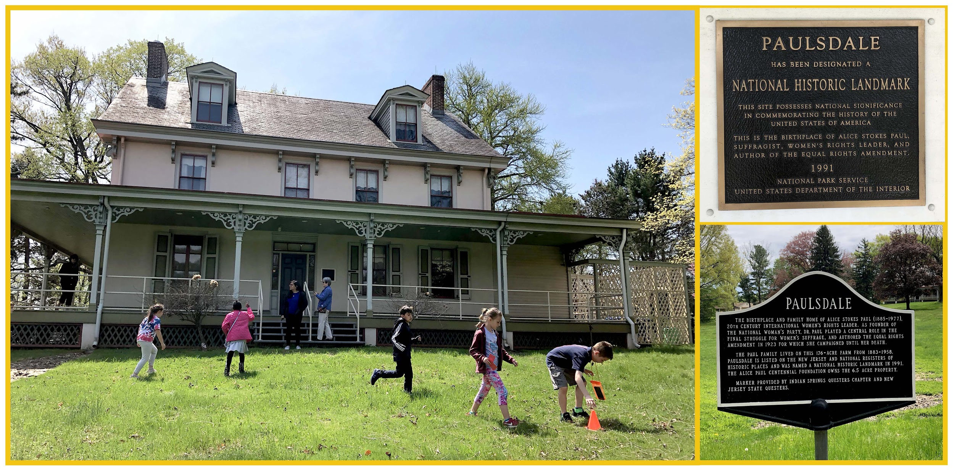
Paulsdale is a National Historic Landmark
Notes:
Paulsdale is the name of the house where Alice Paul was born. It was officially designated a National Historic Landmark in 1991. The children in the photo are participating in a scavenger hunt that is part of the Meeting Alice program at Paulsdale. The two signs at the right recognize the importance of the house.
Teacher Note: Discussion Ideas:
Ask students what a National Historic Landmark is.

Slide 7
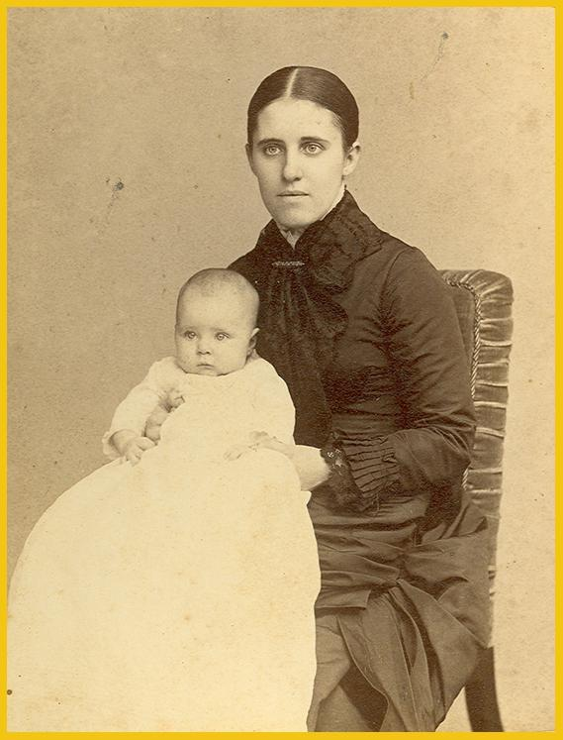
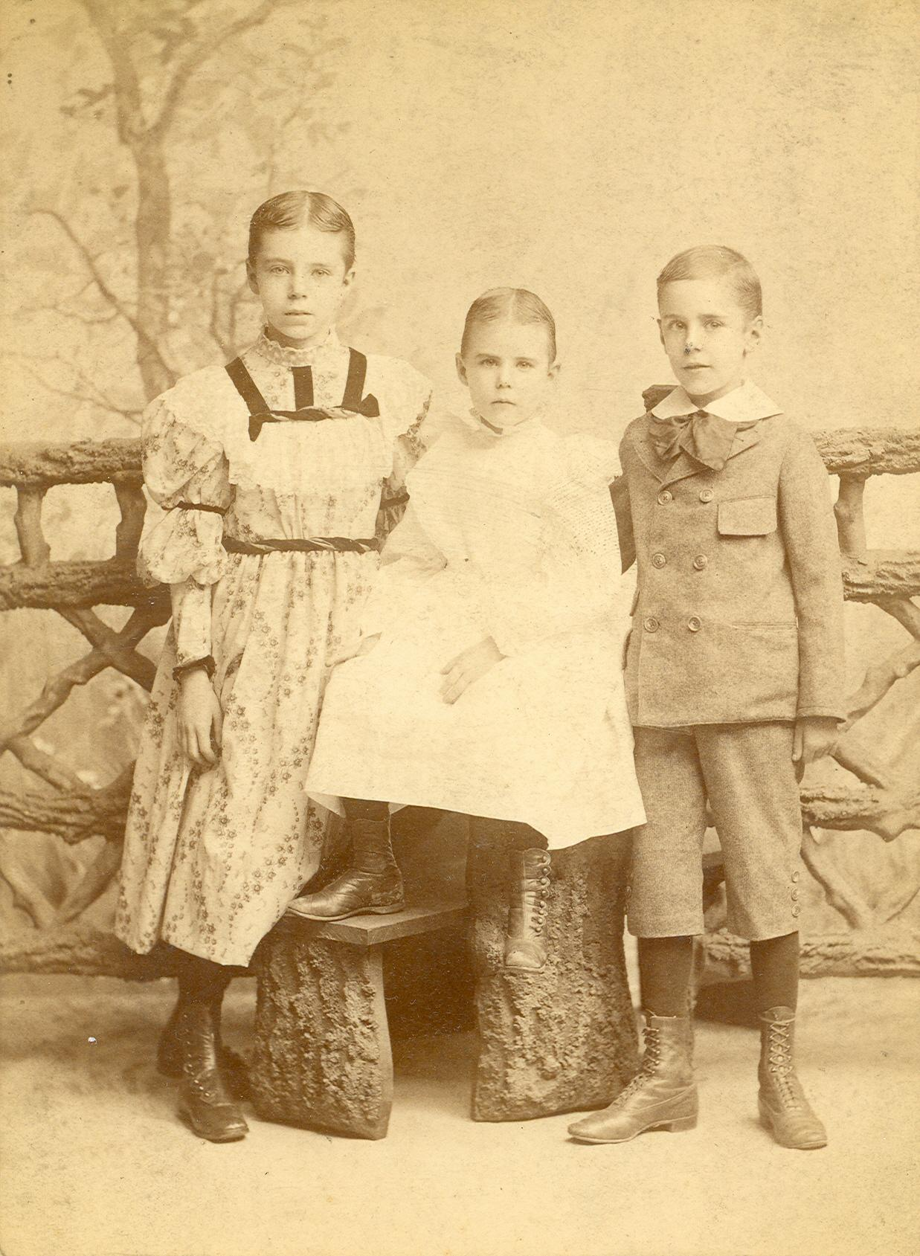
Young Alice
Notes:
The photo on the left shows Alice with her mother, Tacie Stokes Paul. The photo on the right shows Alice with 2 of her 3 siblings.
As a young girl, Alice was reserved and persistent; she was not a typical spot-light-seeking kind of leader. She was the oldest child in her Quaker family. She and her siblings were responsible for chores. Alice was an outstanding and respectful student.

Slide 8
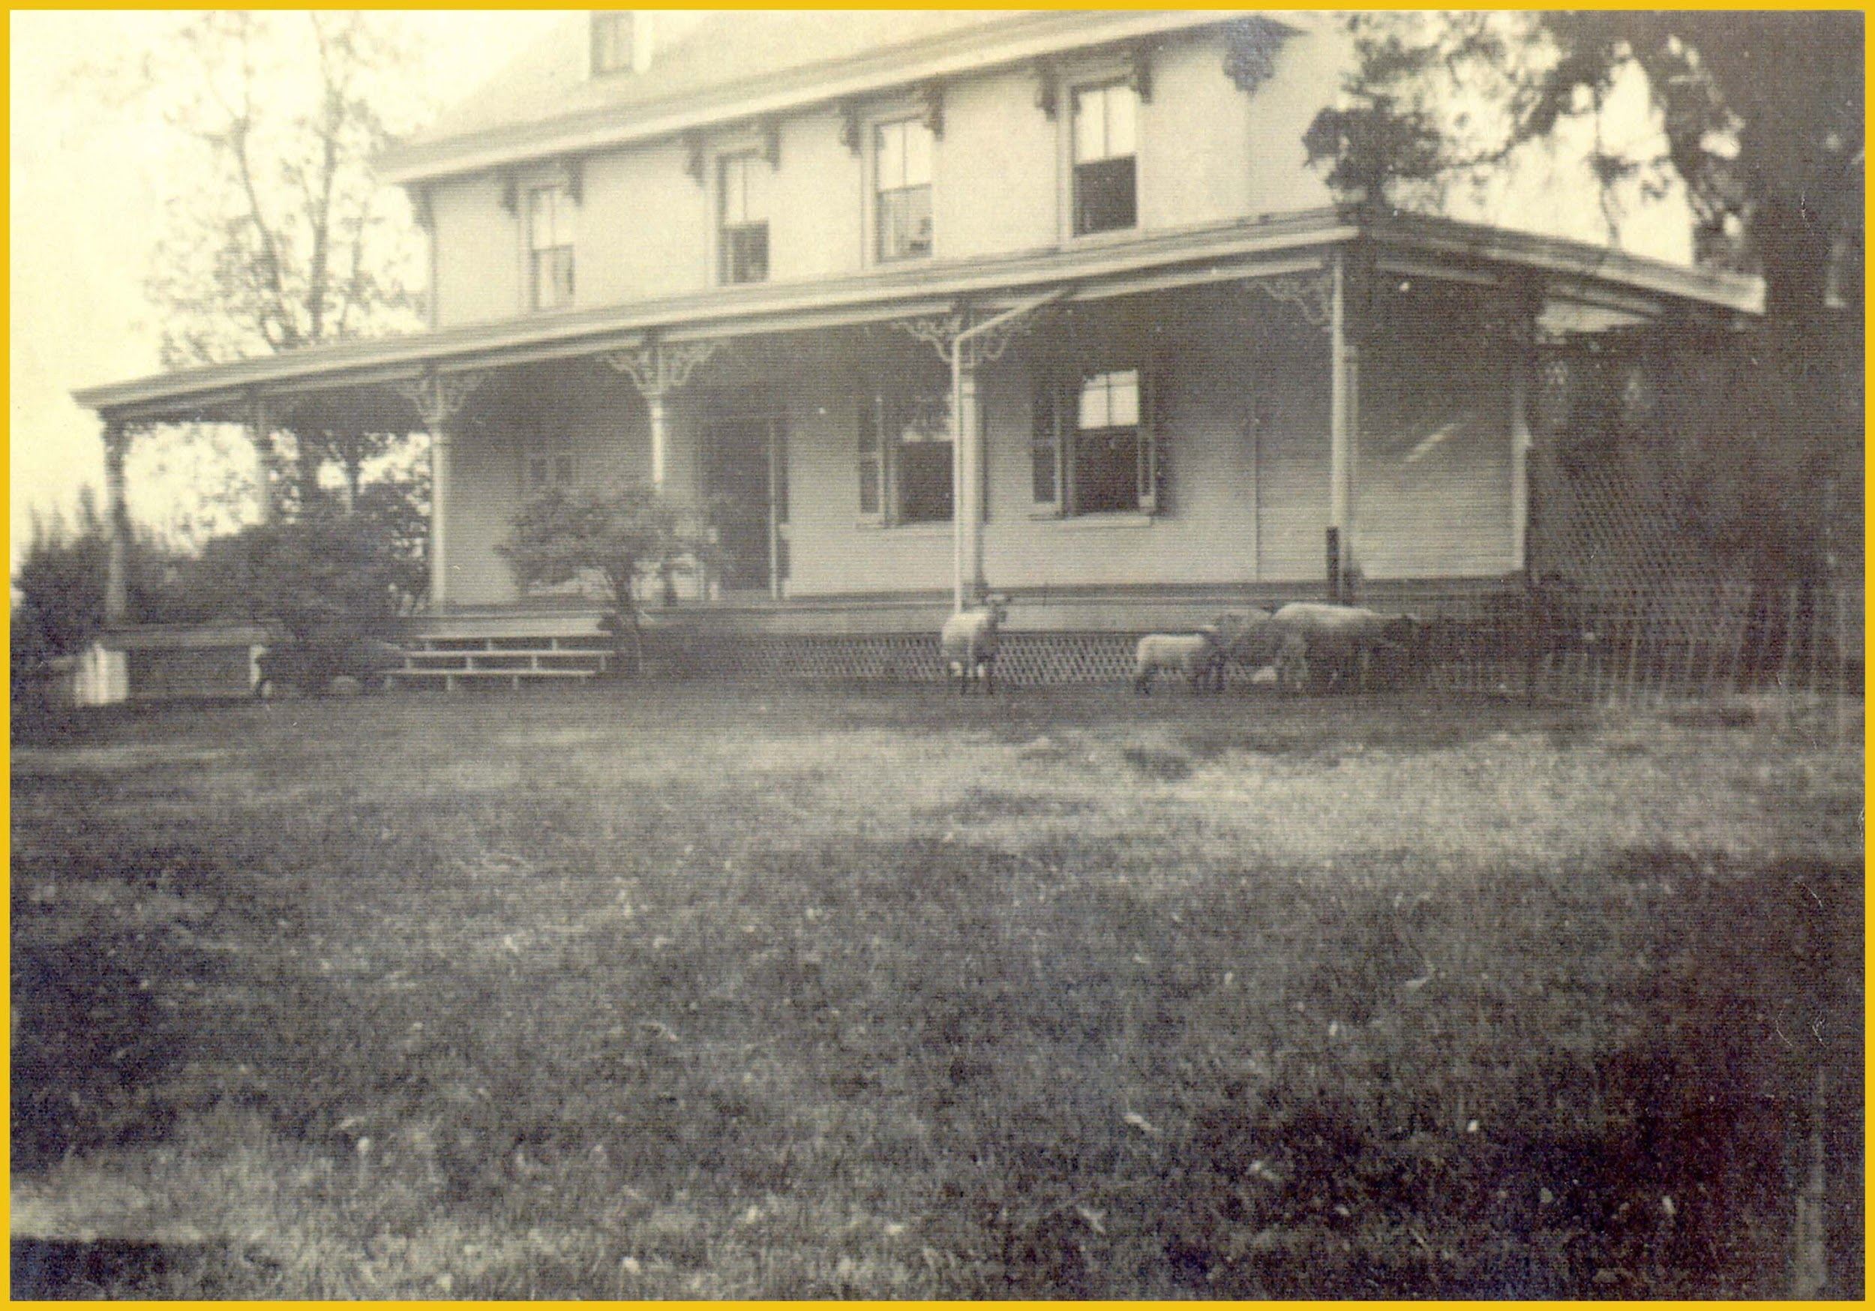
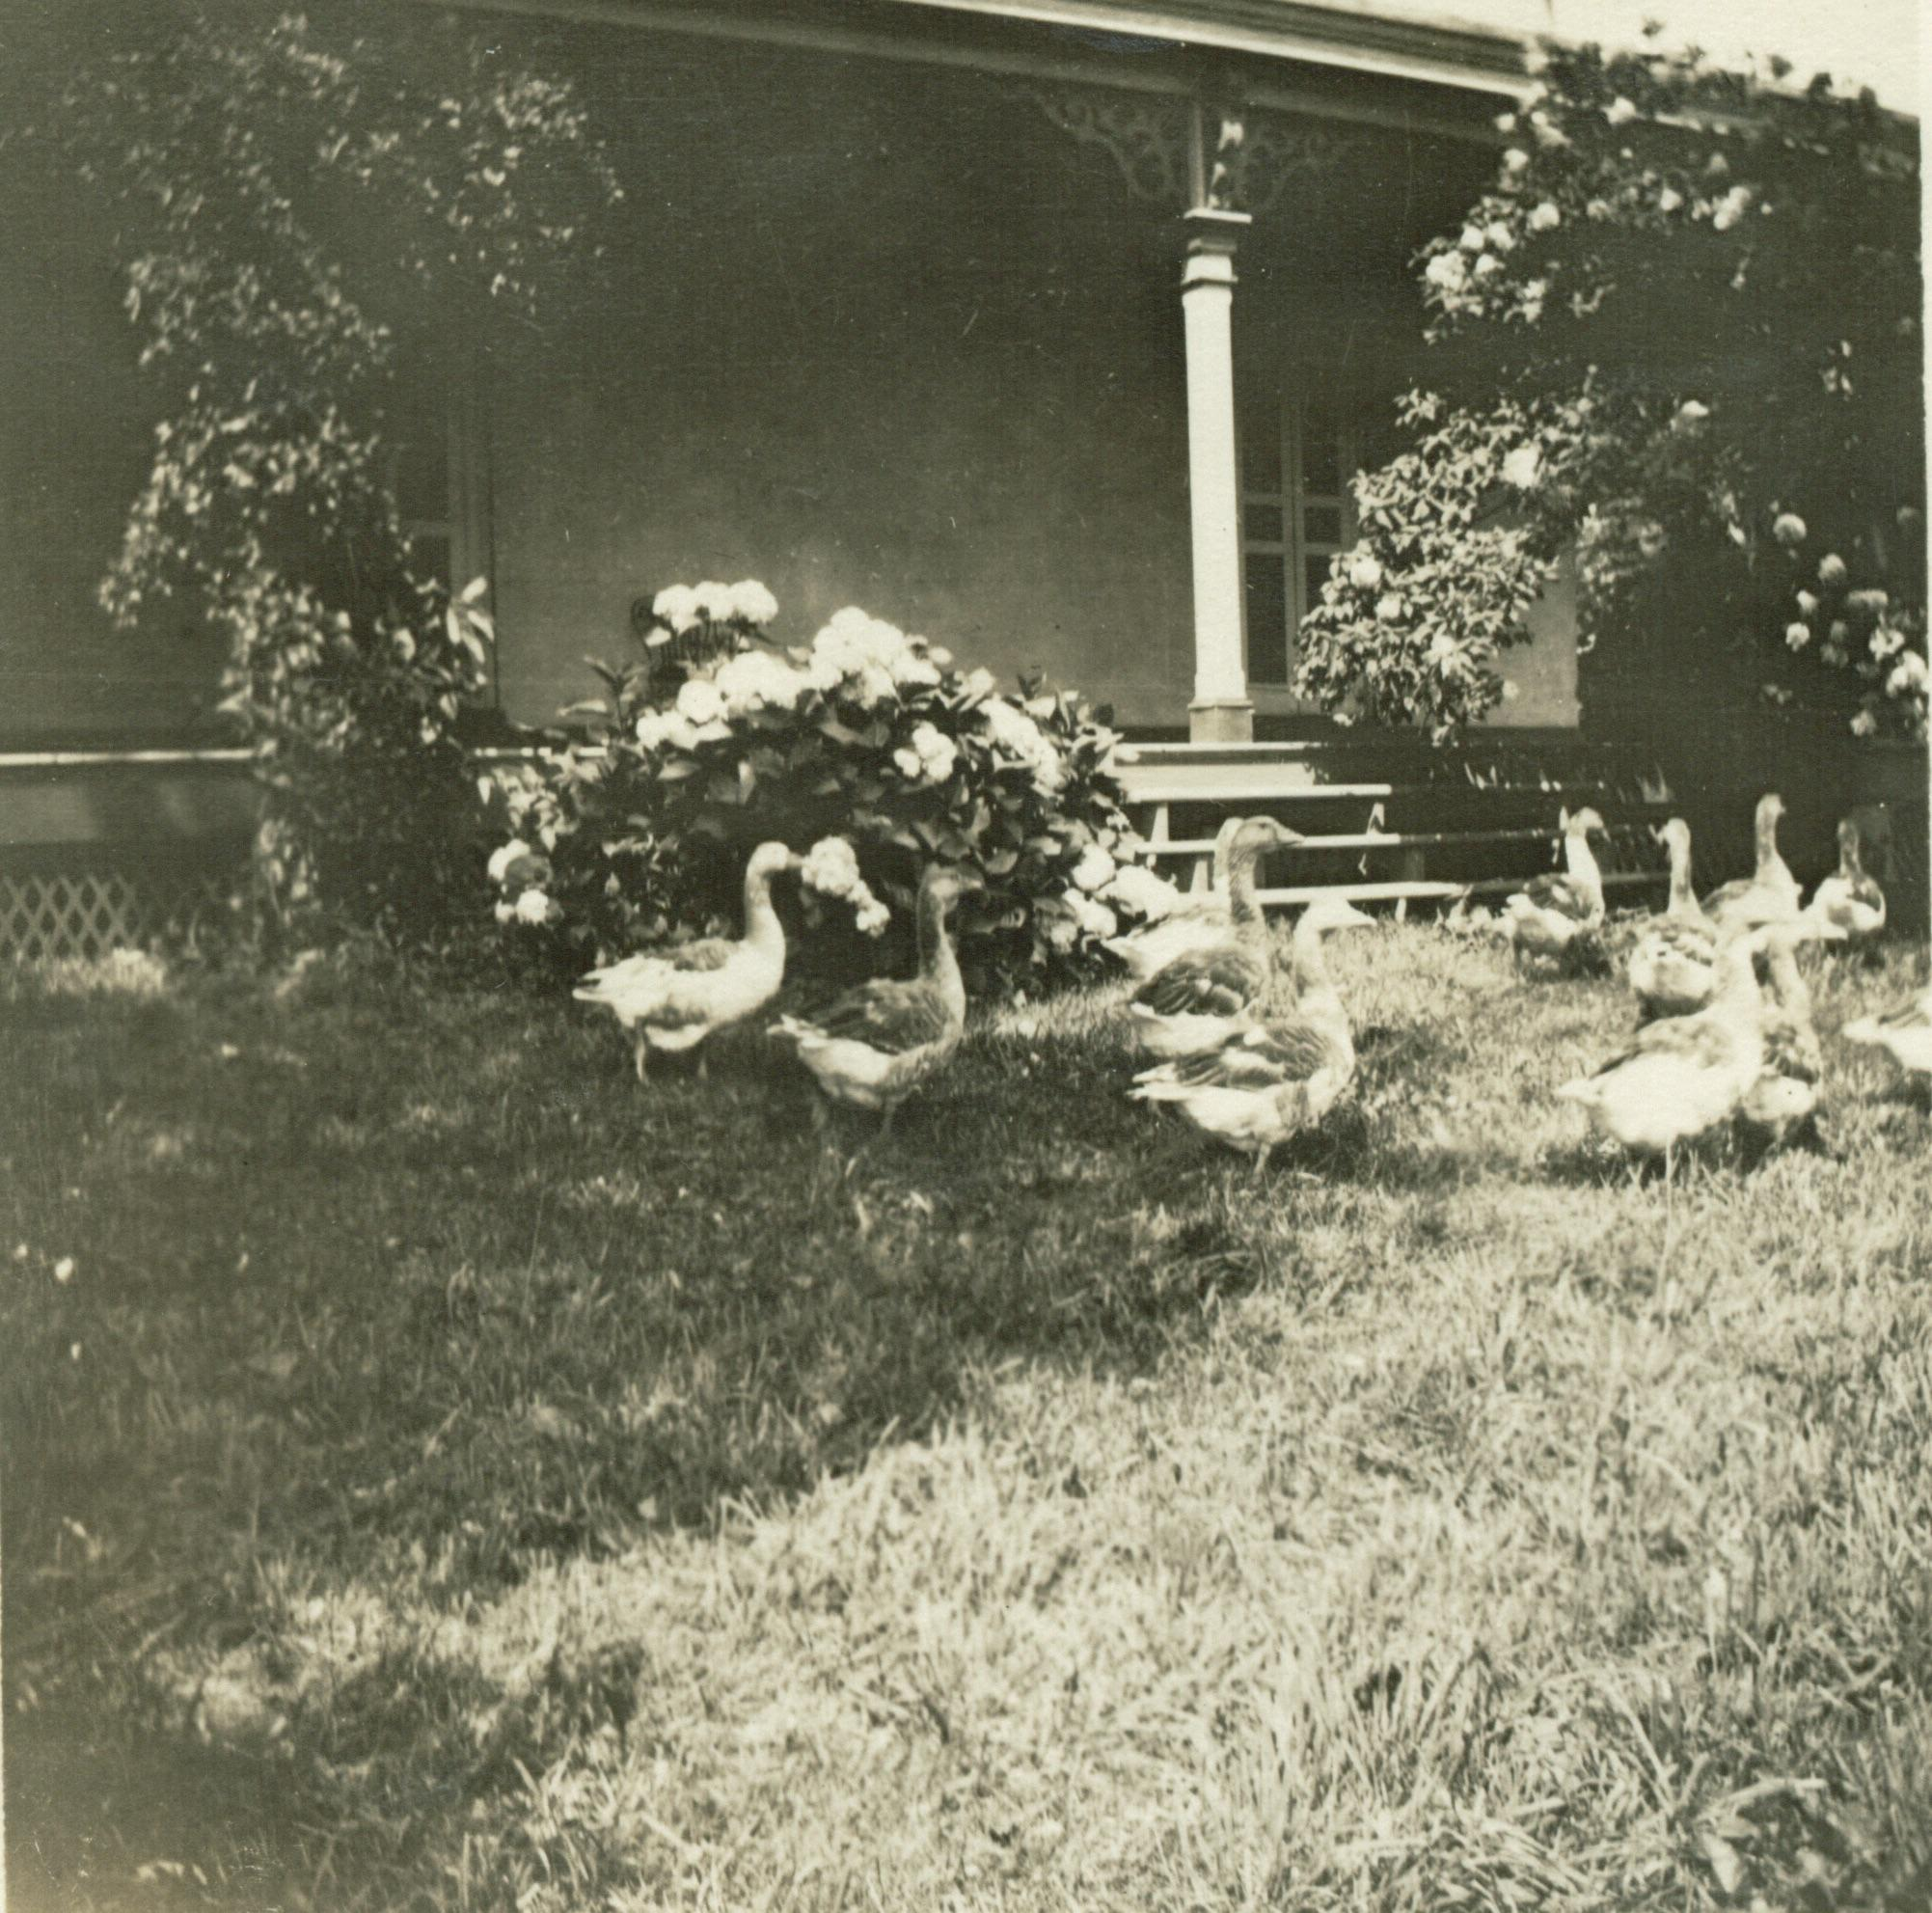
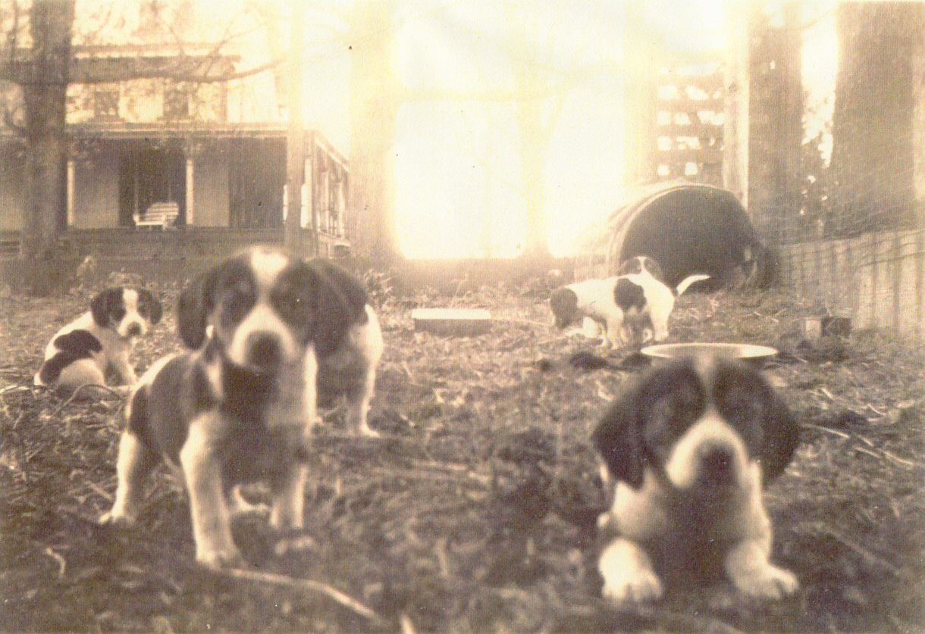
Alice was responsible and showed respect.
Notes:
Alice was born in 1885, at Paulsdale, her home farm. It was a working farm with animals and agriculture. Alice was responsible for chores on the farm. She loved and respected the land on which she grew up, as she tended to her own garden and her own horse. In the photo on the left, you can see the house as it looked when Alice lived there.
Alice was born in 1885 into her Quaker family. She internalized these values and lived her life by them. Quaker values included: No violence (peaceful means to settle disputes) Equality (men and women, boys and girls) Make the world a better place for everyone Discussion ideas:
What chores are you responsible for at home or school? How many of you need to be reminded to do your chores?

Slide 9
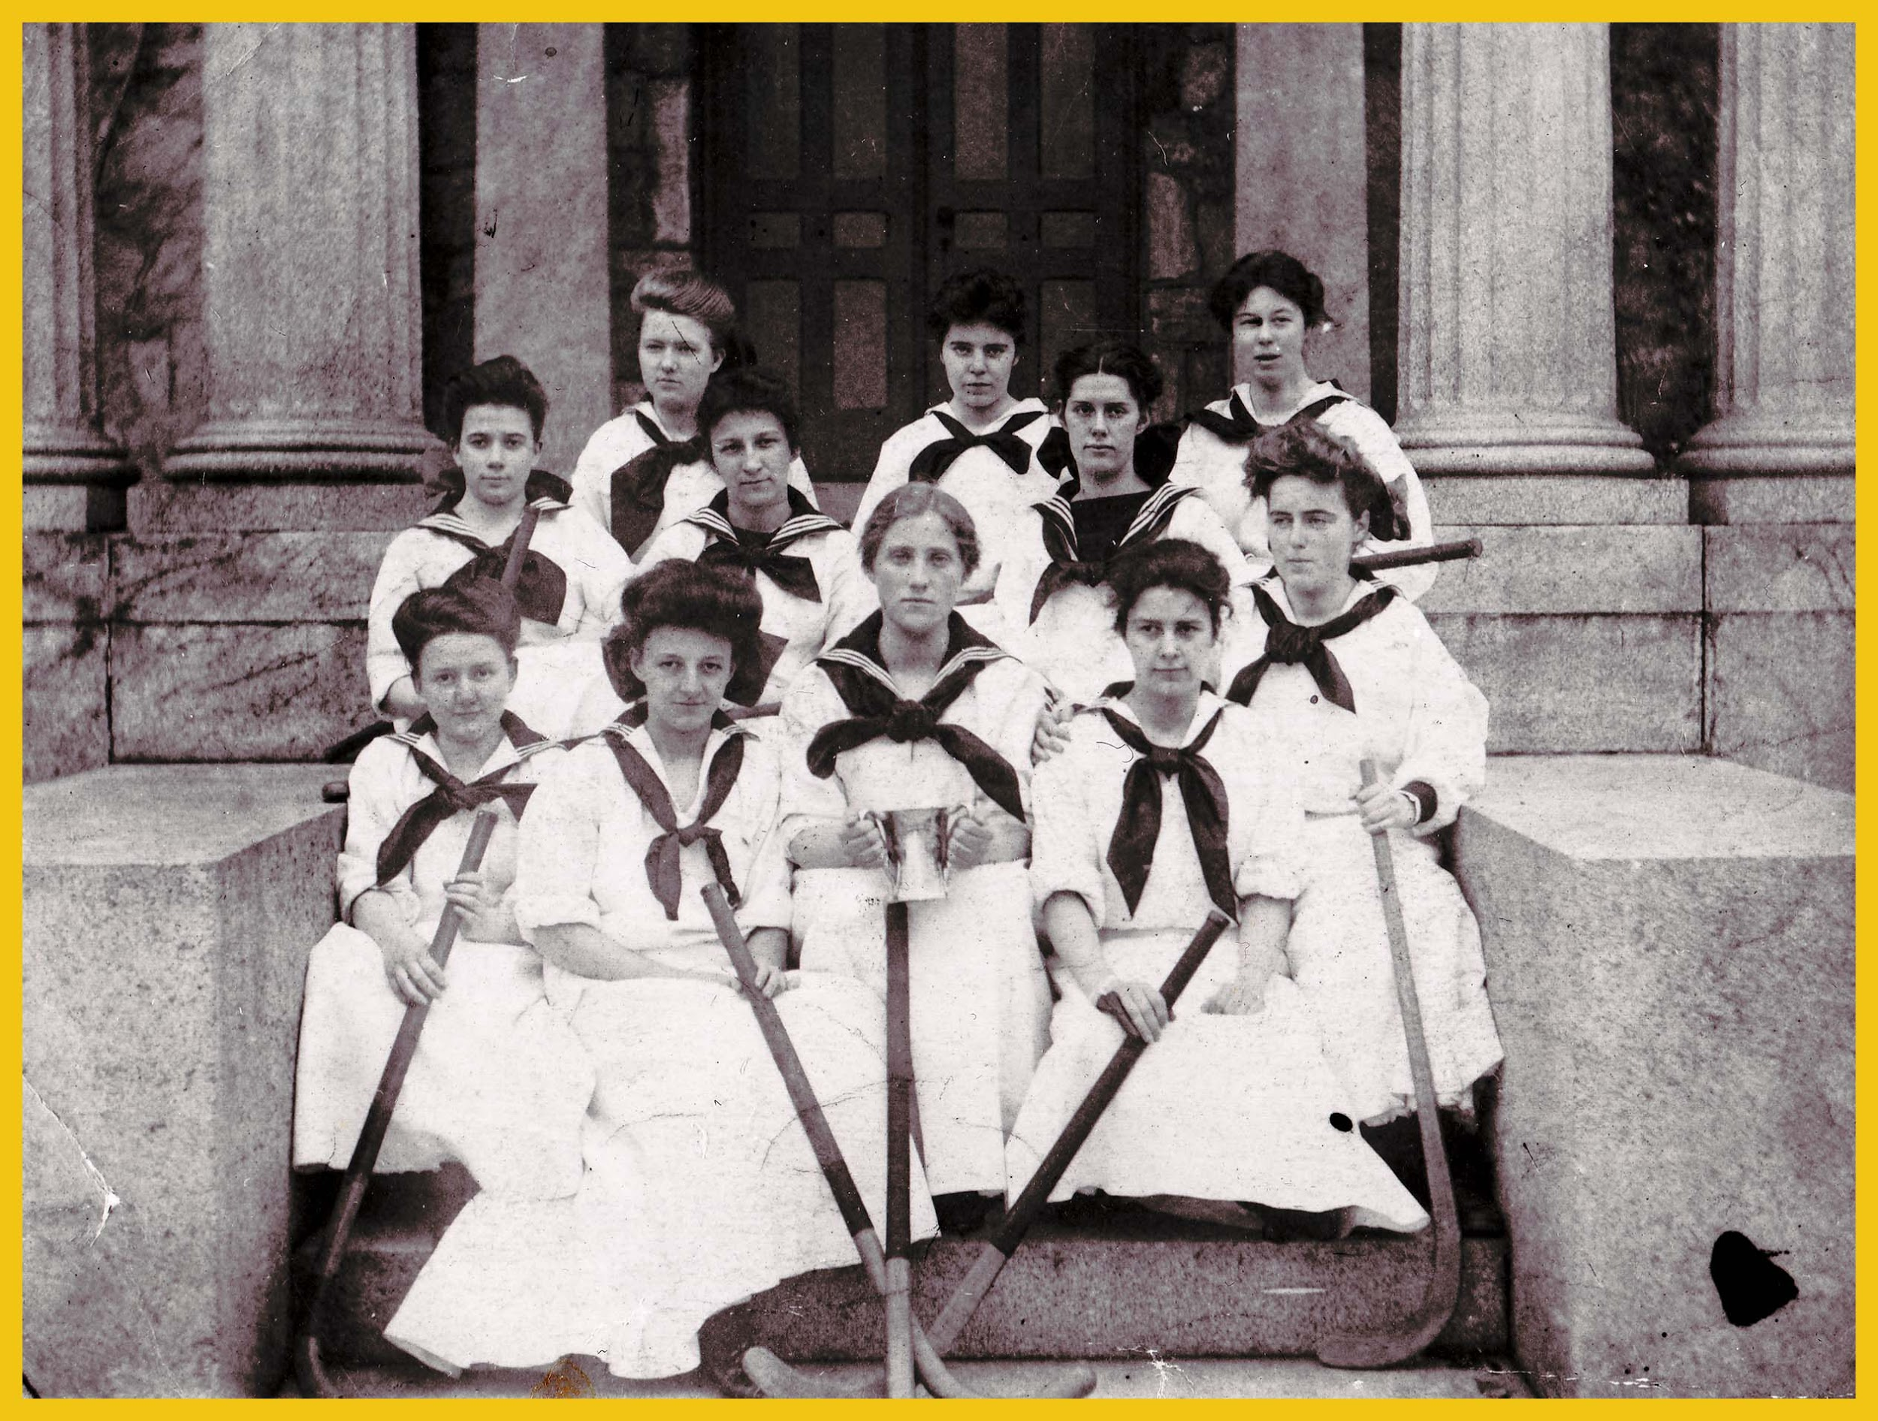
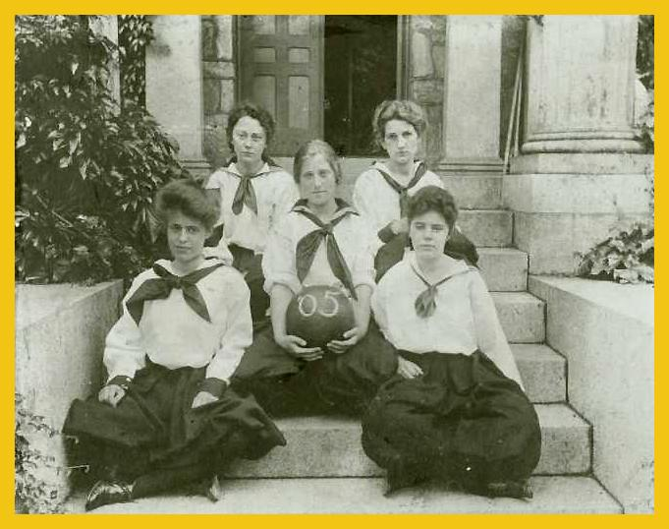
Alice worked well with others.
Notes:
Alice loved to play sports. She played basketball (photo on left) and field hockey (photo on right). She understood the importance of working together with her teammates to play their best. Alice worked well with others.
In the photo of the basketball team on the left side of the screen, you can find Alice in the front row on the far right side. In the photo of the field hockey team on the right side of the screen, Alice is in the middle of the back row.
Teacher Note: Discussion Ideas:
Why is it important to learn how to work well with other people?
Discuss girls’ participation in sports (Title IX).
Discuss uniforms girls wore – why are the girls wearing skirts and dresses?

Slide 10
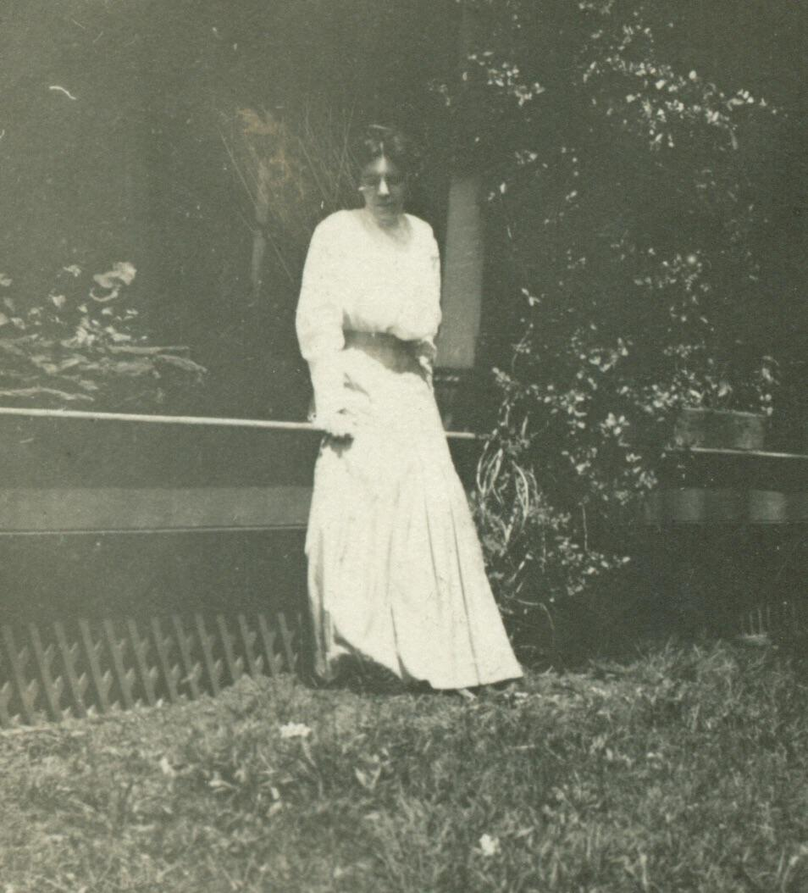
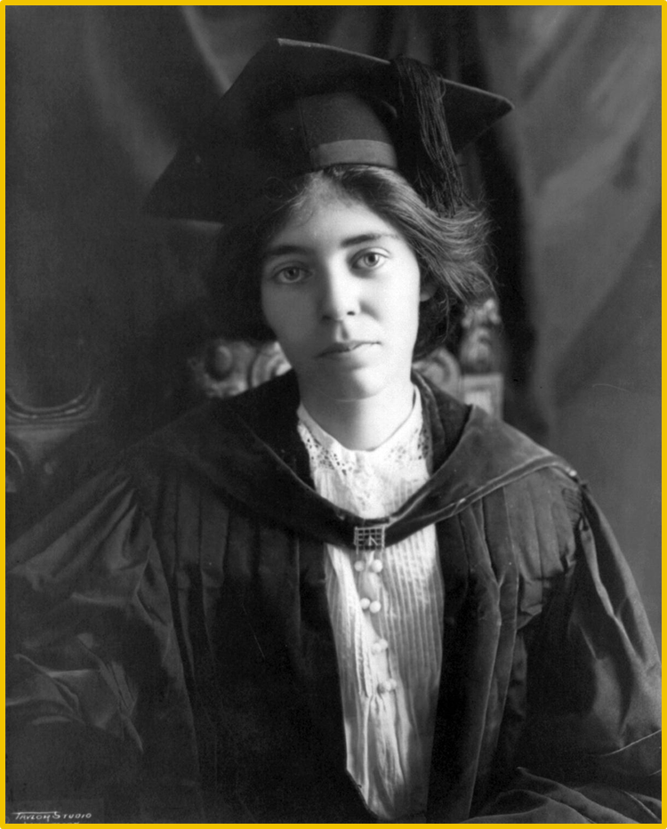
Alice As a Young Woman
Notes:
After high school, Alice attended Swarthmore College, at a time when women typically did not go to college. She went on to hold several different degrees, including three in law.

Slide 11
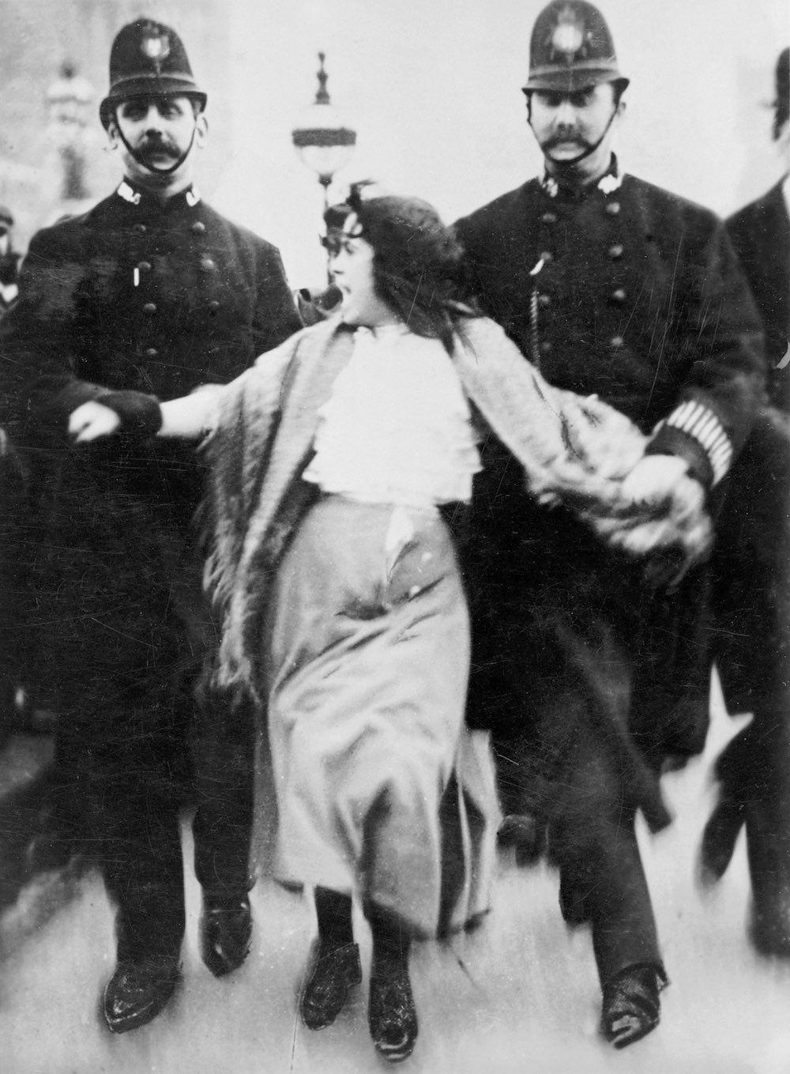
British Suffragette
Notes:
Alice was inspired by the suffragettes in England. The term used in England was suffragette. (In the United States, the term was suffragist). This photo depicts a suffragette being arrested by British police, called Bobbies.

Slide 12
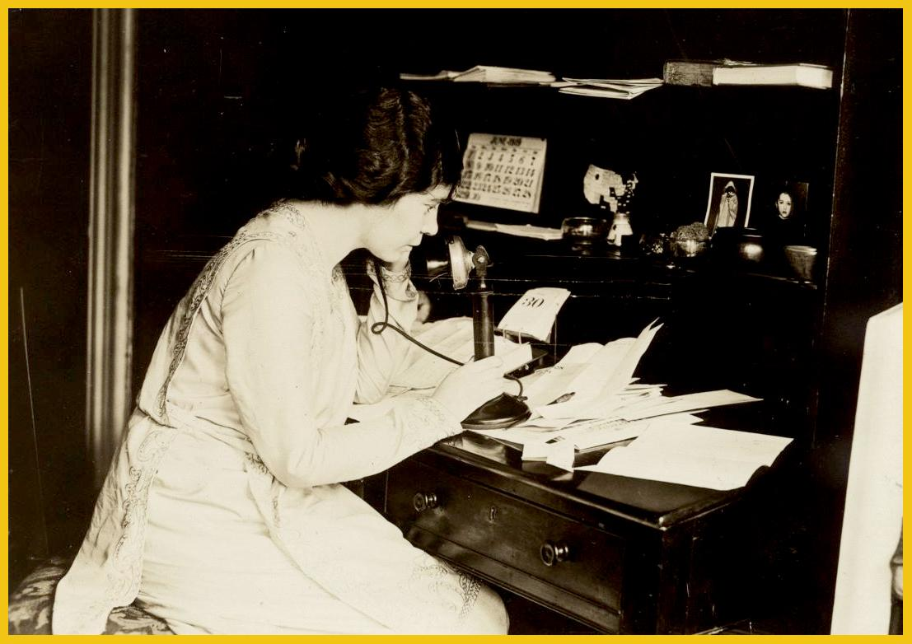
Alice was a leader.
She set goals.
She was
organized.
She had good
communication
skills.
Notes:
Upon returning from England, Alice was determined to work for suffrage for women in the United States. She became a leader in the suffrage movement.
Alice set goals. In order to accomplish her goals, she needed to be organized in her mind and have good communication skills.
She made numerous phone calls and wrote many letters in her effort to raise support for women’s suffrage. In this photo, she is busy at her desk at the headquarters of the National Woman’s Party in Washington, D.C.
Teacher Note: Discussion Ideas:
Point out the telephone to the class.
Do you set goals?
Are you organized?
Do you have good communications skills?

Slide 13
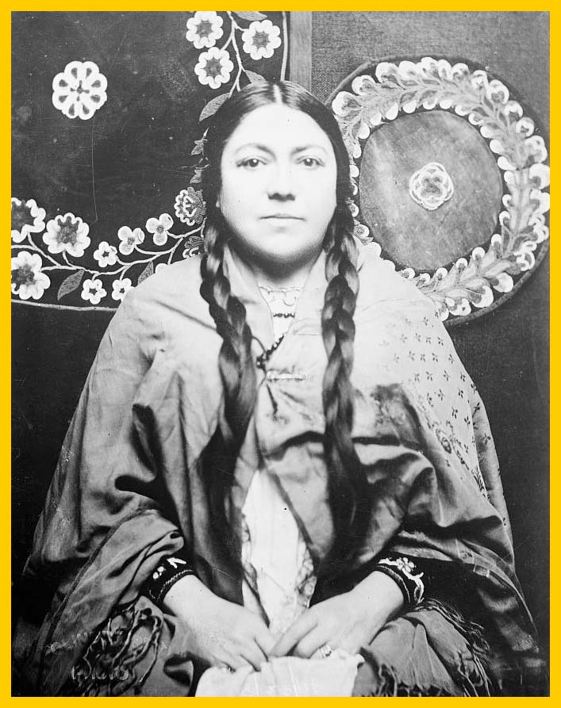
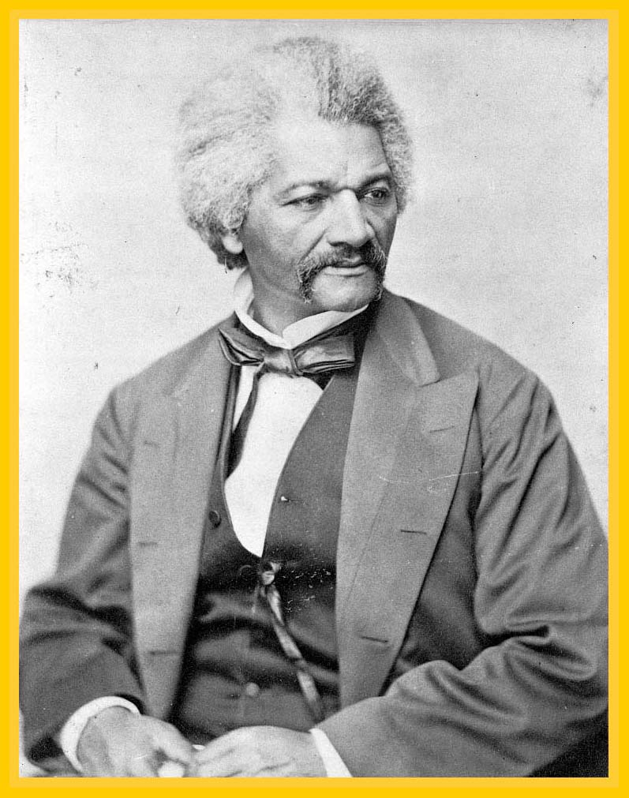
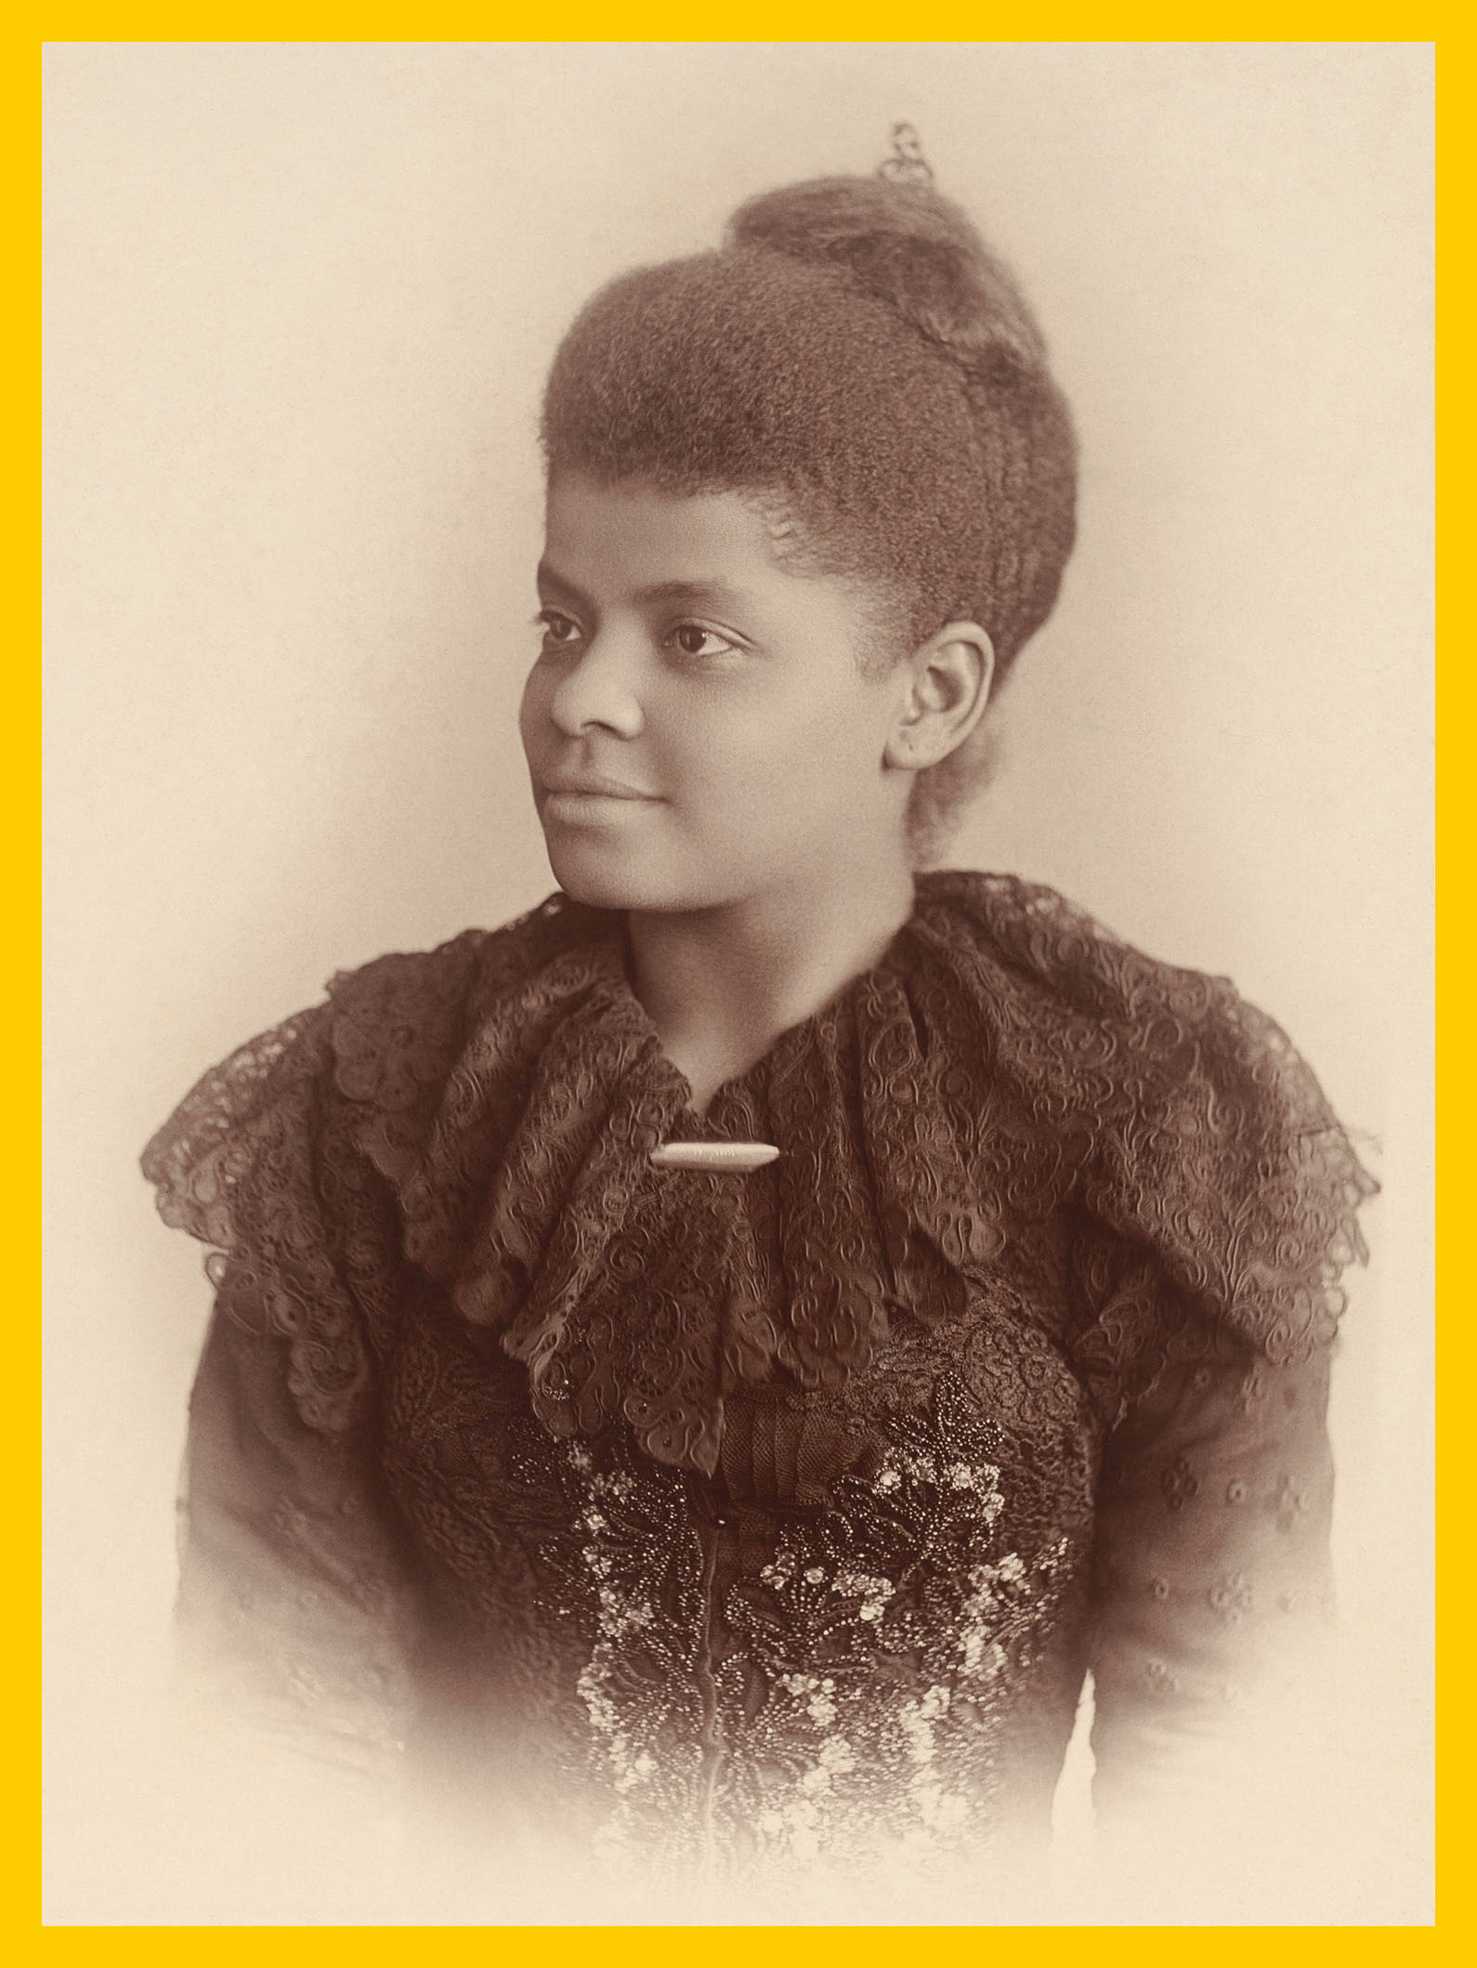
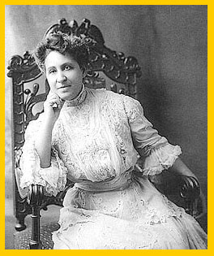
Marie Baldwin
Marie Louise
Bottineau Baldwin
Frederick Douglass
Ida B. Wells-Barnett
Mary Church Terrell
Ida B Wells
Notes:
Americans who supported the suffrage movement came from all walks of life and were a diverse group of individuals.
Ida B. Wells was a prominent journalist, activist, and educator. She was a leader of the early Civil Rights Movement, a noted suffragist, and one of the founders of the NAACP. Ida marched in the 1913 parade with Alice.
Marie Baldwin was a Chippewa and Ojibwe Indian who served in the Department of Indian Affairs under president Theodore Roosevelt. She became the first woman of color to graduate from the Washington College of Law and spent much of her life advocating for indigenous women. Marie also marched with Alice in the 1913 parade.
Mary Church Terrell was an educator and activist who worked to advance the societal position of African Americans. She fought for suffrage and civil rights, and helped found the NAACP.
Frederick Douglass was an abolitionist, writer, and speaker. After escaping from slavery in Maryland, he spent the rest of his life championing social justice causes, including women’s suffrage.

Slide 14
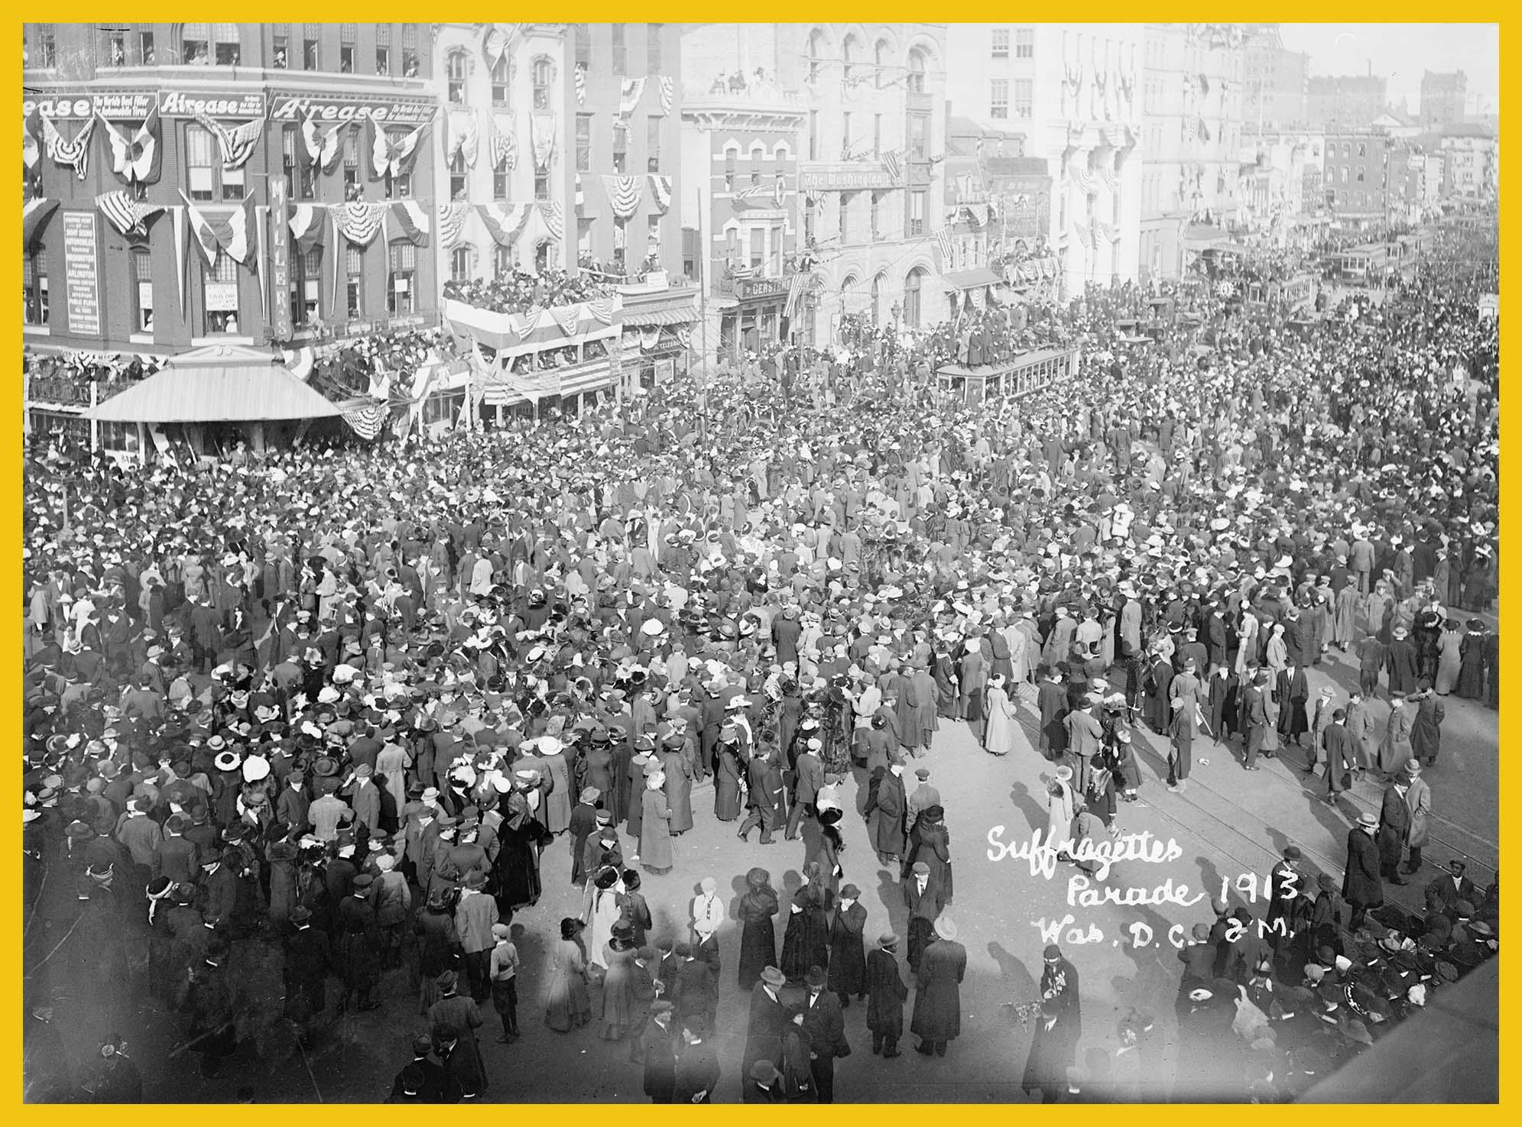
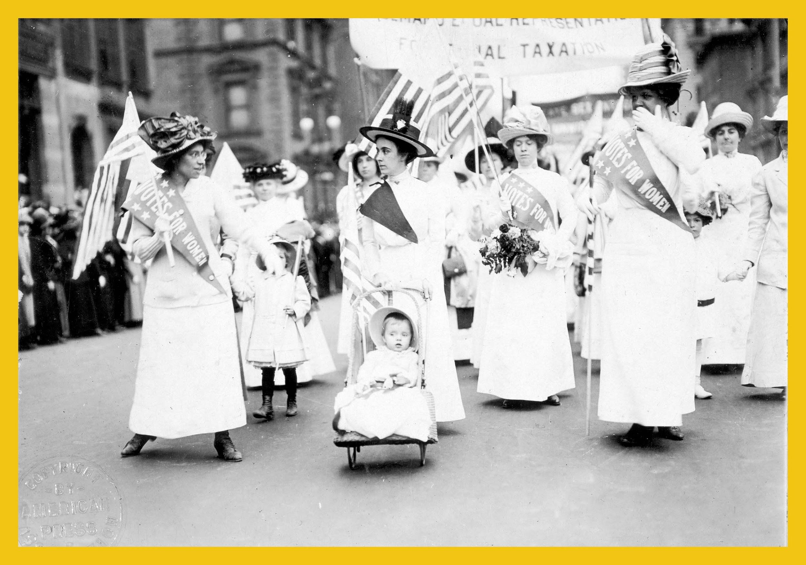
1913
Notes:
Alice used her skills to organize a huge parade in Washington, D.C. Over 8,000 women, children, AND men participated in the parade to show their support for women’s suffrage.
Alice chose to hold the parade on the same day that the newly-elected President of the United States, Woodrow Wilson arrived in Washington, DC. When he arrived, he wondered why so few people were there to welcome him. This was because so many people chose to attend the parade that Alice Paul organized.
The day after the parade was Inauguration Day, the day that newly elected presidents take the oath of office.
President Wilson did not actively support the women’s suffrage movement.
Teacher Note: Discussion Ideas:
What do you notice in the photos of the parade?

Slide 15
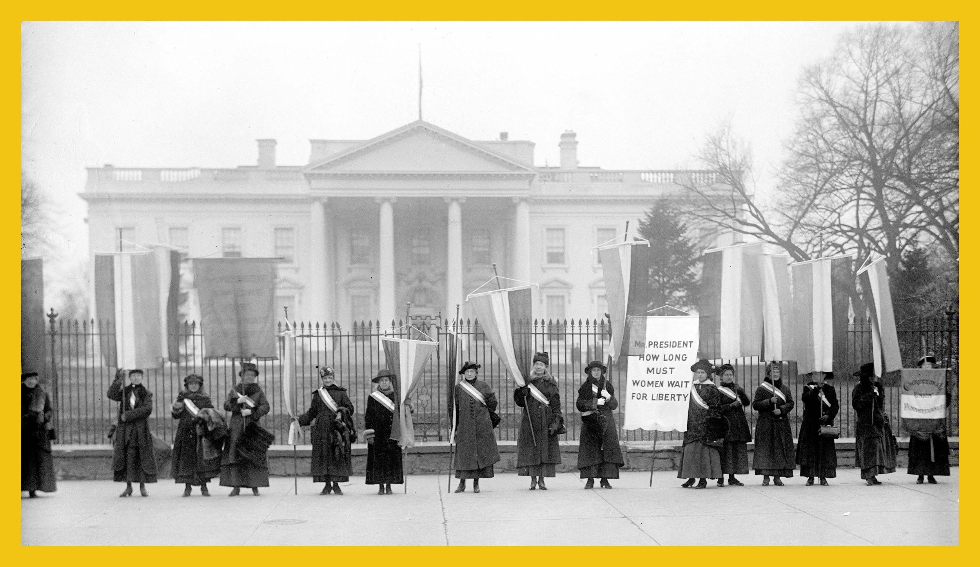
1917
Notes:
Alice Paul was brave. In order to achieve her goal of winning the right to vote for women, she sometimes did things that no one had dared to do before.
In 1917, through her organization, the National Woman’s Party, Alice Paul organized hundreds of women to come together in a very public display of protest in front of the White House. No one had ever dared to picket in front of the White House, but Alice Paul did.
Remember, as a Quaker, Alice Paul believed in acts of peace and non-violence. She wanted to bring greater attention to the suffrage movement, and she did not want people to be harmed. She and many other suffragists stood peacefully and silently on the sidewalk in front of the White House to picket in support of their right to vote.
Because these women did not speak but let their signs and sashes convey their message, they were called “Silent Sentinels”. They practiced non-violent protest to avoid conflicts with people who were upset with their brazen public protest.
Beginning on January 10, 1917, the Silent Sentinels stood outside the White House, 6 days a week, 8 hours a day, rain or shine throughout most of that year. After months of picketing, the suffragists were arrested by police on the charge of blocking traffic. However, the suffragists stood silently on the sidewalk, while the onlookers created traffic blockage in the streets.
It is important to note that the Silent Sentinels were NOT arrested for picketing. Picketing is a protected right in the United States through the 1st Amendment of the U.S. Constitution.
Interactive Activity:
Have students stand silently with their arms raised (as if they were holding a banner). The teacher should time this for about 2 minutes. The teacher can speak to the students, but the student “picketers” must remain silent as the women did while they were picketing. Discuss with the students their feelings during this time. Remind them that the picketers stood in all weather, for hours at a time.
Teacher Note: Discussion Ideas:
Can you read the words on the banner? What do they mean?
What is picketing? Have you ever seen people picket?
What does non-violent protest mean?
Remember the women were silent. How did the banners speak for them?
What did the sashes worn by many women symbolize?
Photo Credit: Library of Congress

Slide 16
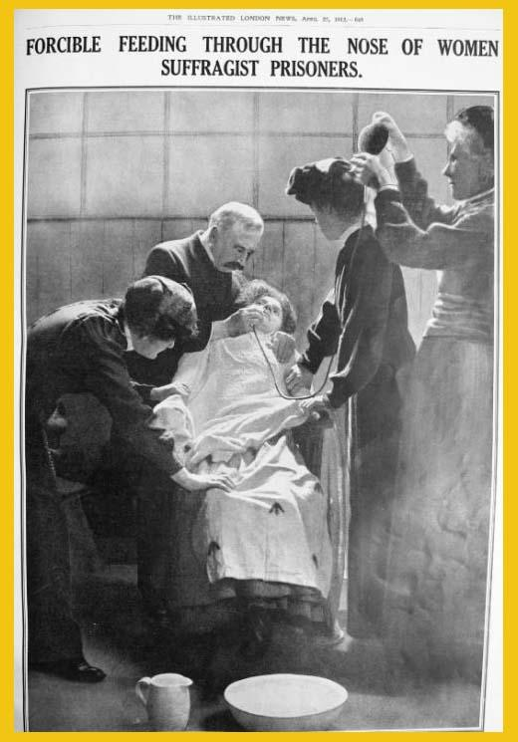
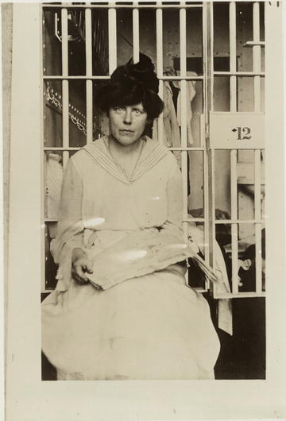
Alice and 168
suffragists were arrested and went to jail.
In jail, they conducted
a hunger strike
and were
force fed.
Notes:
In the spring of 1917, Alice Paul and 168 other suffragists were arrested and sent to jail. While in jail, the women were treated badly. The jail cells were disgusting and filthy. Conditions were deplorable: blankets and clothes were washed once per year, food contained bugs and weevils, and access to fresh air was not available.
Alice led the jailed women on a hunger strike to draw attention to their causes. Some suffragists participated with her. The women were forcibly fed three times per day through a very painful process. First, each woman was restrained. Next, a doctor inserted a tube into the nose of the woman, guiding the tube down her throat. Then a nurse poured a combination of liquid eggs and milk through a funnel into the tube. This process directed the mixture into the stomach of the woman. This caused the women great pain and left many with lifelong medical issues. If you look at the photo illustration on the right, you can see an artist’s interpretation of the process.
Teacher Note: Discussion Ideas:
How do you feel when you have not eaten?
What do you think of the treatment of the suffragists in jail?
Photo Credit: Library of Congress (left); The Illustrated London (right)

Slide 17
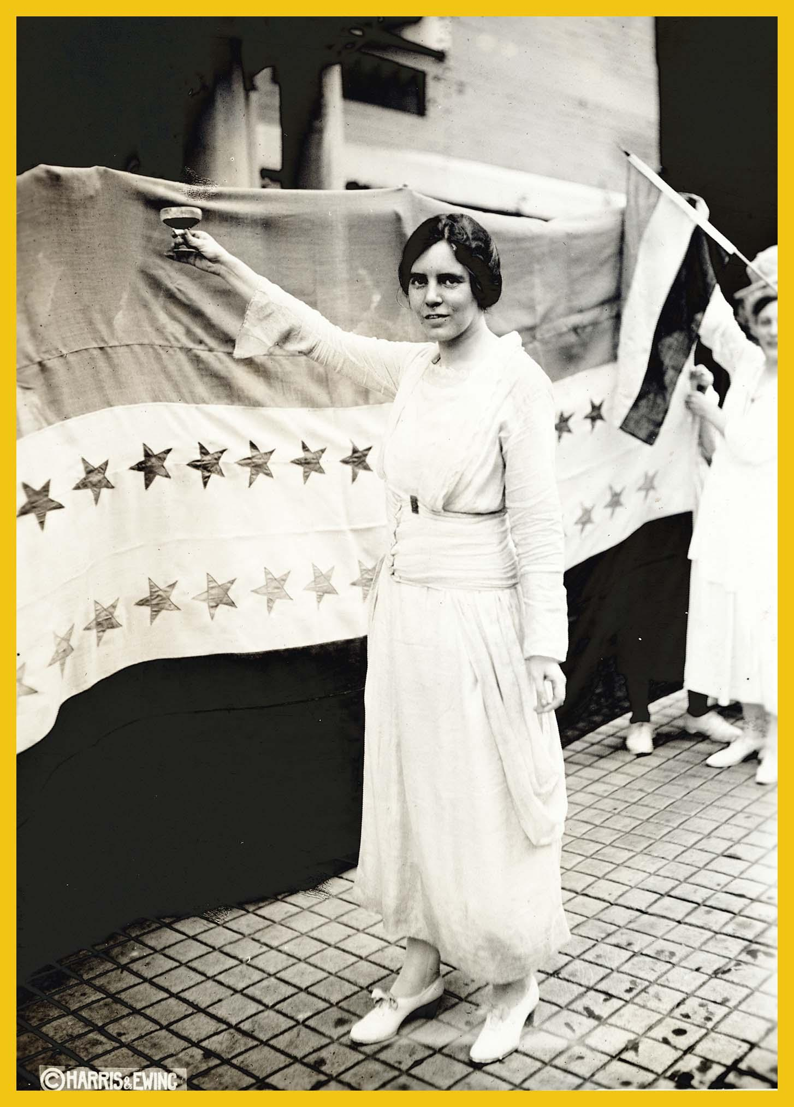
States that ratified the 19th Amendment:
1919:
Illinois
Wisconsin Michigan Kansas
Ohio New York Pennsylvania
Massachusetts
Texas Iowa Missouri Arkansas Montana Nebraska Minnesota New Hampshire
Utah
California
Maine
North Dakota
South Dakota
Colorado
1920:
Connecticut
Kentucky
Rhode Island
Oregon
Indiana
Wyoming
Nevada
New Jersey
Idaho
Arizona
New Mexico
Oklahoma
West Virginia
Washington
Tennessee*
1921 & After:
Vermont (1921)
Delaware (1923)
Maryland (1941)
Virginia (1952)
Alabama (1953)
Florida (1969)
South Carolina (1969)
Georgia (1970)
Louisiana (1970)
North Carolina (1971)
Mississippi (1984)
* The 19th Amendment needed a total of 36 states to ratify it to the United States Constitution. Tennessee became the 36th state in August of 1920.
August 1920
Notes:
When people began to hear about the brutal treatment of the suffragists in jail, public pressure grew until the women were finally released. Their demands for the ratification of the 19th Amendment were taken to President Woodrow Wilson. Under great public pressure, Wilson asked Congress to pass the legislation and send the amendment to the states to be ratified. A total of 36 states needed to pass the legislation to ratify the 19th Amendment.
In 1919, a total of 22 states voted to ratify the 19th Amendment. In 1920, an additional 14 states voted to ratify, resulting in the amendment having the required total of 36 states. The 36th state to ratify was Tennessee. The vote was so close that it passed by only one vote. State Senator Harry Burns of Tennessee was originally against the amendment, but after he received a letter from his mother asking him to vote “Yes,” he voted in favor of the amendment, casting the deciding vote.
On August 26, 1920, the 19th Amendment, granting women the right to vote, was added to the United States Constitution. Alice Paul and so many others celebrated this dynamic moment in history.
Teacher Note: Discussion Ideas:
What year did our state ratify the 19th Amendment?
Emphasize how one vote can make a difference!
Important fact: The photo of Alice was taken during Prohibition. It is grape juice in her glass.
Photo Credit: Library of Congress

Slide 18
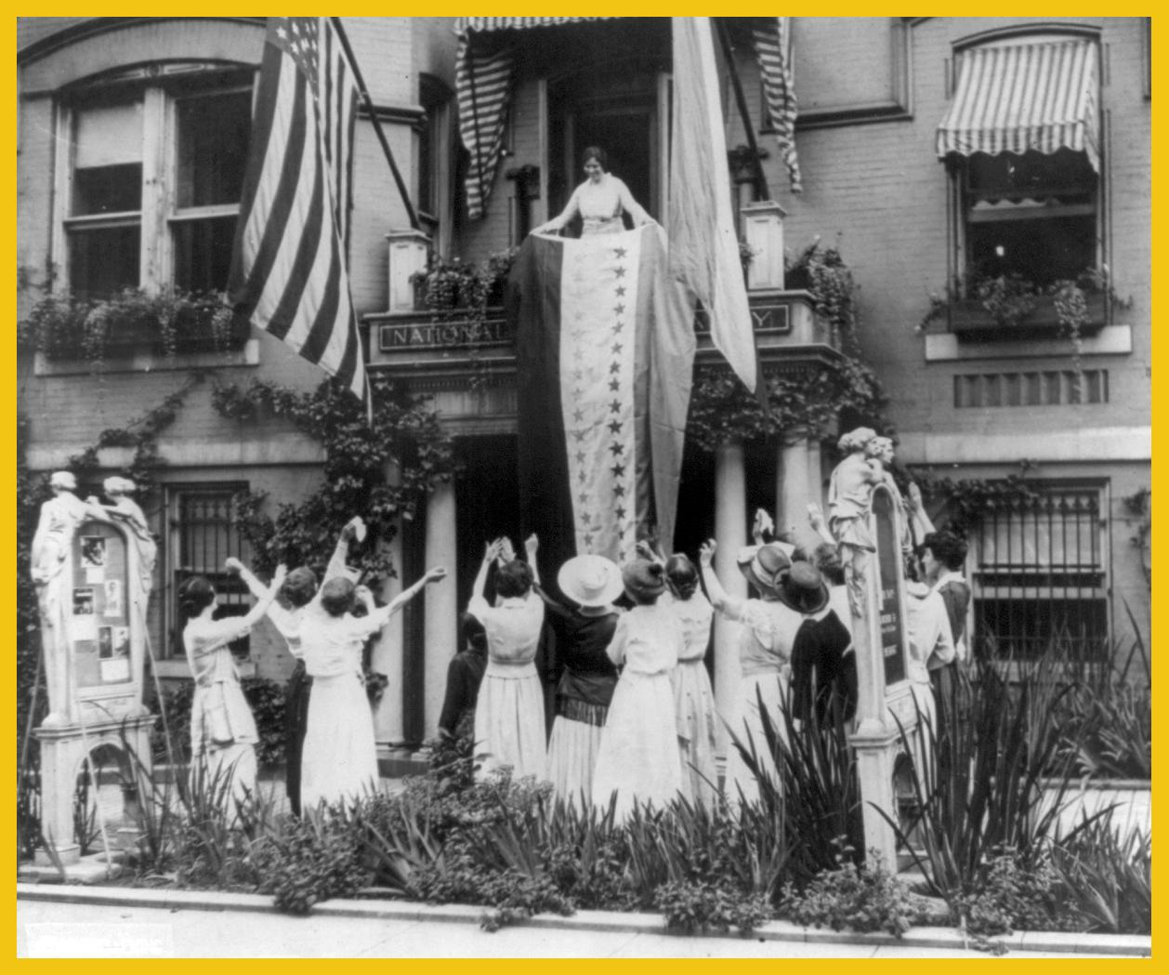
Alice persevered.
She did
not stop working toward equality.
Notes:
Alice was creative and persevered to reach her goals. In this photo, she is standing on the balcony unfurling the hand-made suffrage flag over the entrance to the National Woman’s Party Headquarters in Washington, DC. The building is now a National Historic Site and is called the Belmont-Paul Women's Equality National Monument. Visitors from around the world can see her desk and the bedroom where she slept.
After the 19th Amendment was successfully ratified, Alice Paul did not end her fight for equality. She continued her work to make sure that all women and men in America were viewed and treated equally. Just three years later, in 1923, Alice Paul wrote and introduced another amendment to the United States Constitution, the Equal Rights Amendment, which after 96 years, has yet to be ratified.
The Equal Rights Amendment says: “Equality of rights under the law shall not be denied or abridged by the United States or by any state on account of sex.”
To learn more about the Equal Rights Amendment, please visit: www.EqualRightsAmendment.org
Teacher Note: Discussion Ideas:
What qualities make a good leader?
Which of these qualities do you have?
Photo Credit: Library of Congress

Slide 19
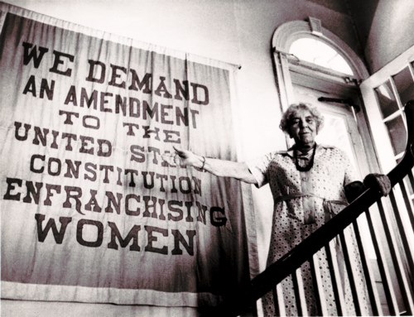
Alice in Her Later Years
Notes:
Alice Stokes Paul dedicated her entire life to making the world a better place. She died on July 9, 1977, and is buried in the Quaker cemetery in Cinnaminson, NJ.

Slide 20
“I never doubted
that equal rights was
the right direction. Most reforms, most problems, are complicated. But to
me there is nothing complicated about
ordinary equality.”
Alice Paul
“When you put your hand to the plow, you can’t put it down until you get to the end of the row.” - Alice Paul
“When there is something
to be done, I bank on Alice.”
William Paul, Alice’s father
Notes:
One of Alice Paul’s most well-known quotes relates to her belief that equality is not complicated. She said,
“I never doubted that equal rights was the right direction. Most reforms, most problems, are complicated. But to me there is nothing complicated about ordinary equality.”
Fun Fact: Alice Paul’s father, William Paul, was a banker. (See his quote on the slide show.)
Teacher Note: Discussion Ideas:
What did Alice mean by the term “ordinary equality”?
What did Alice mean when she said that when your hand is on the plow, you can’t stop the plow until you reach the end of the row?
Alice Paul’s father, William Paul, believed in her tenacity to get things done. Are you a person who people can rely on to get things done?

Slide 21
Alice Paul believed that one person can make a difference.
Now it is your turn!
How will YOU make a difference?
Notes:
Alice Paul believed that one person can make difference and make the world a better place for everyone. She was one person, a girl born on a farm in New Jersey, who persevered, developed her leadership skills, and had a big impact on democracy in America by fighting to get women the right to vote in elections.
Teacher Note: Discussion Ideas:
How will YOU make a difference?
What issues are important to you?
What leadership skills do you have?
How can you improve your leadership skills?
Do you believe you can make a difference?

